Slide 1
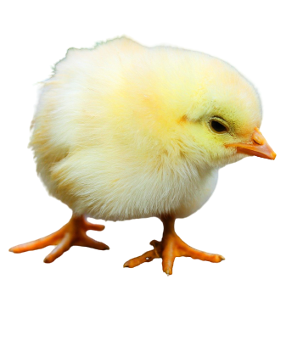
The Hatching of a Chick

Slide 2
Attention, kind teachers:
Thank you for exploring alternatives to chick-hatching projects! The following slide show is designed for use as part of TeachKind’s lesson for grades K–2 about the development of a chick embryo. We encourage you to use this free resource instead of live chicks. For more information and free resources, please visit TeachKind.org or e-mail us at Info@teachkind.org.

Slide 3
Objectives
Students will be able to do the following:
Describe the development of a chick embryo
Identify the parts of a developing chicken
Describe the needs and wants of a chicken

Slide 4
Key Vocabulary
Domesticated
Needs
Wants
Sanctuary
Hen
Rooster
Chick
Embryo

Slide 5
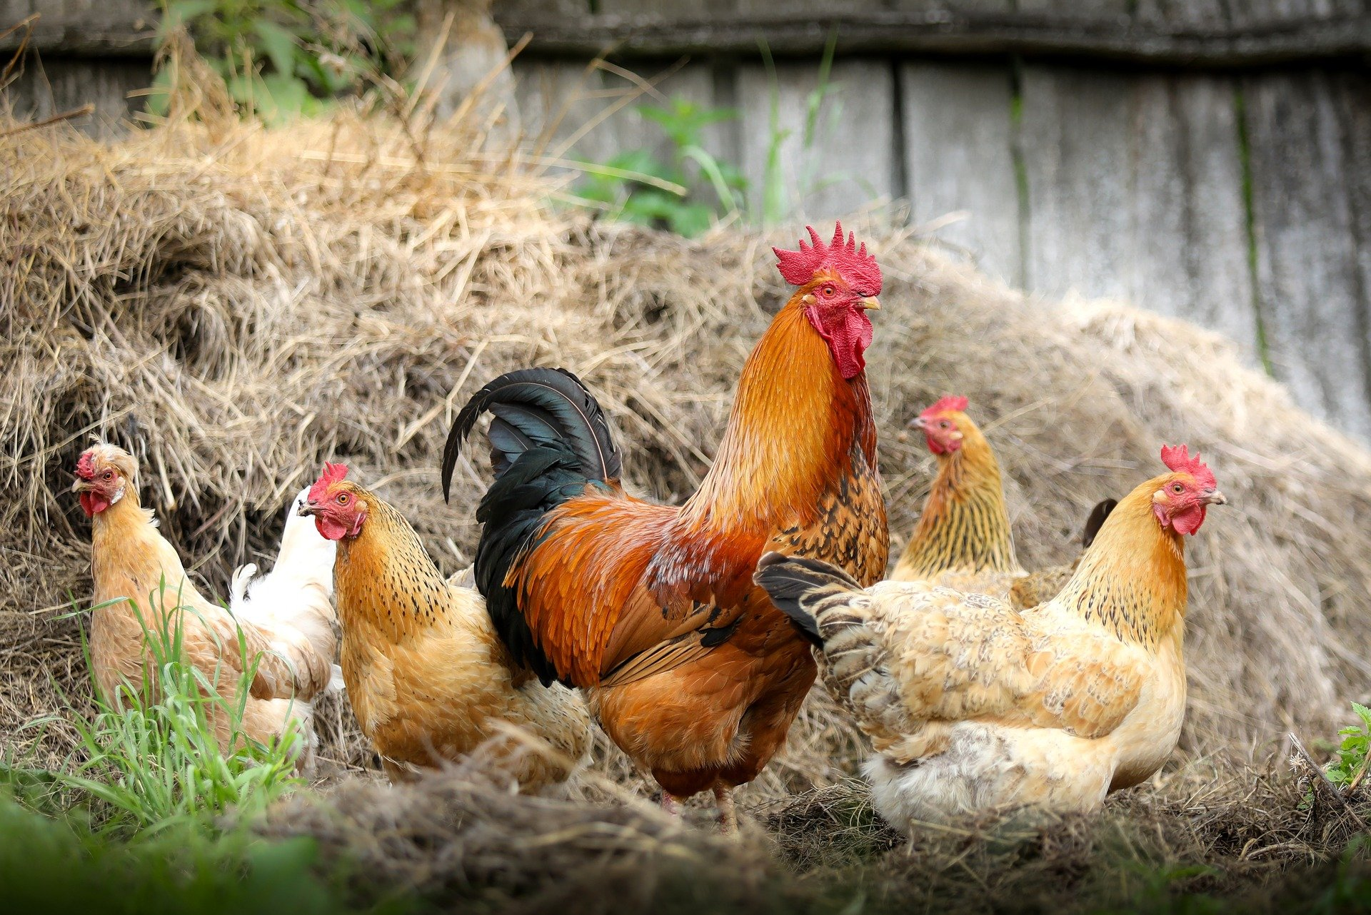
Chicken Facts
Like dogs and cats, chickens are domesticated animals. This means that they rely on humans to meet their needs.

Slide 6
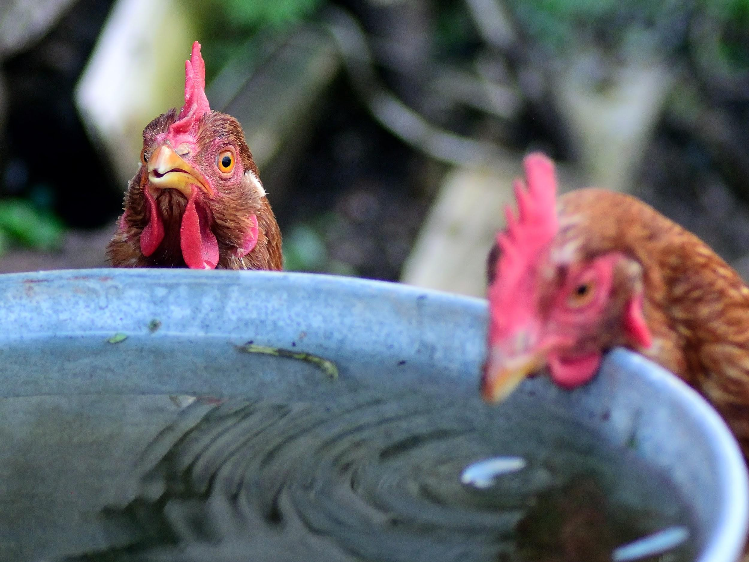
Chicken Facts
Like humans and all other animals, chickens need:
Food
Water
Shelter
Safety
Room to move around
Their mothers!

Slide 7
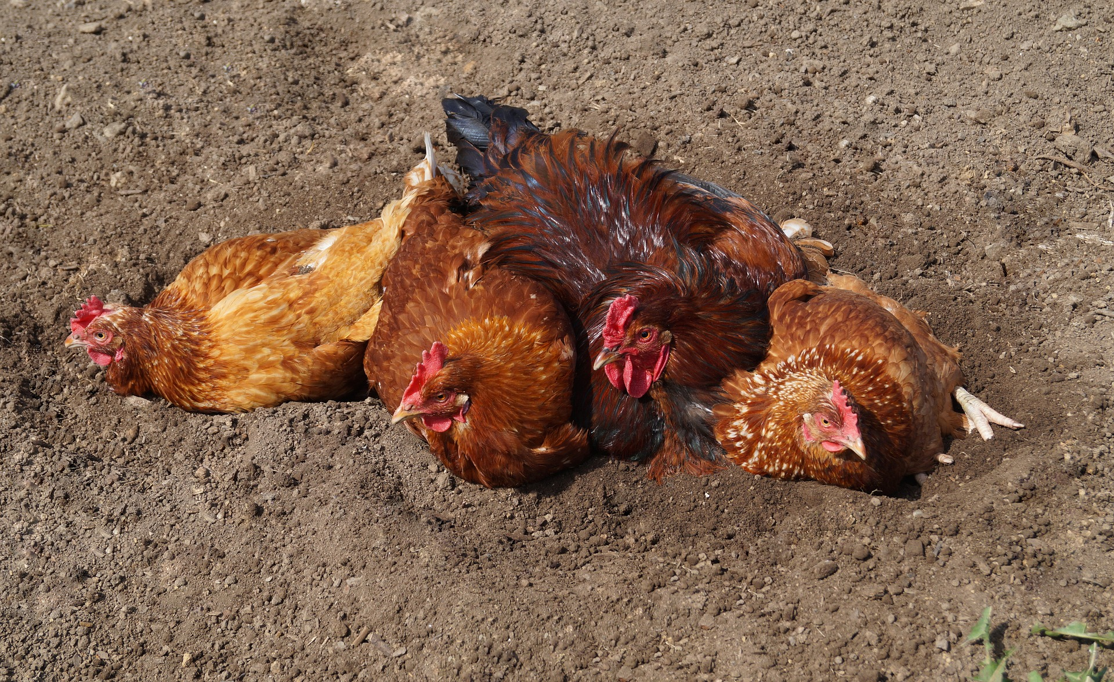
Chicken Facts
Chickens also have wants like these:
Being with their family
Taking dust baths
Stretching their wings
Looking for yummy things to eat in the grass

Slide 8
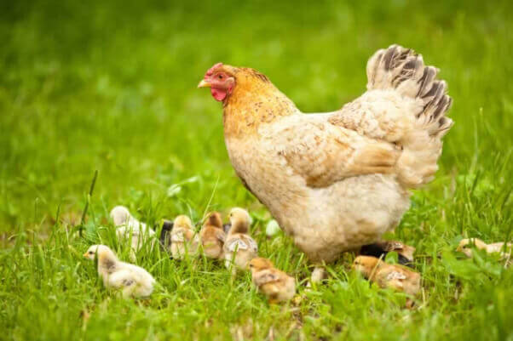
Chicken Facts
Most chickens live on large factory farms, where many of their needs and wants are not met.

Slide 9
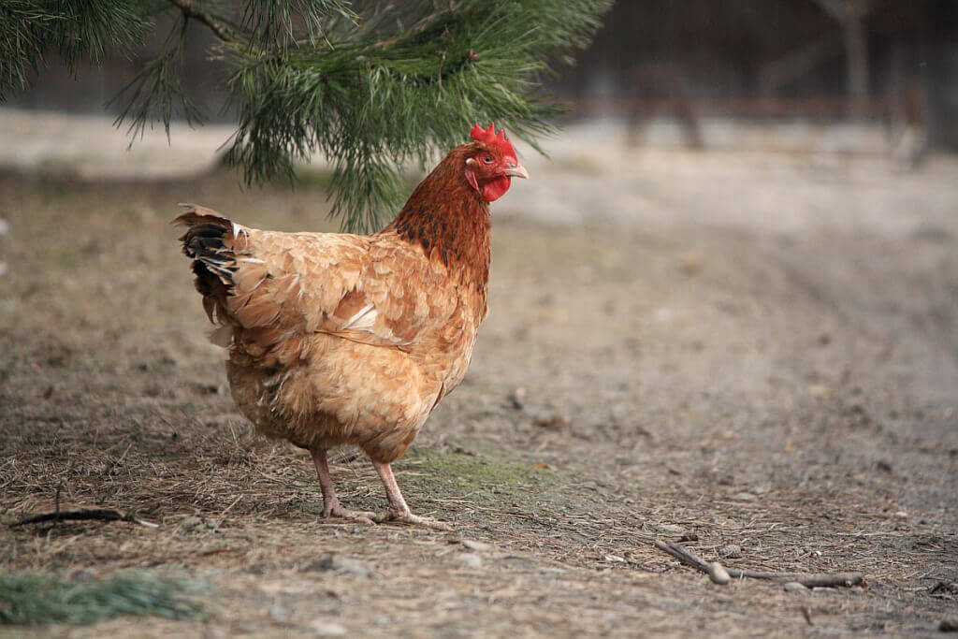
Chicken Facts
Some chickens are lucky enough to live in sanctuaries, where all their needs and wants are met.

Slide 10
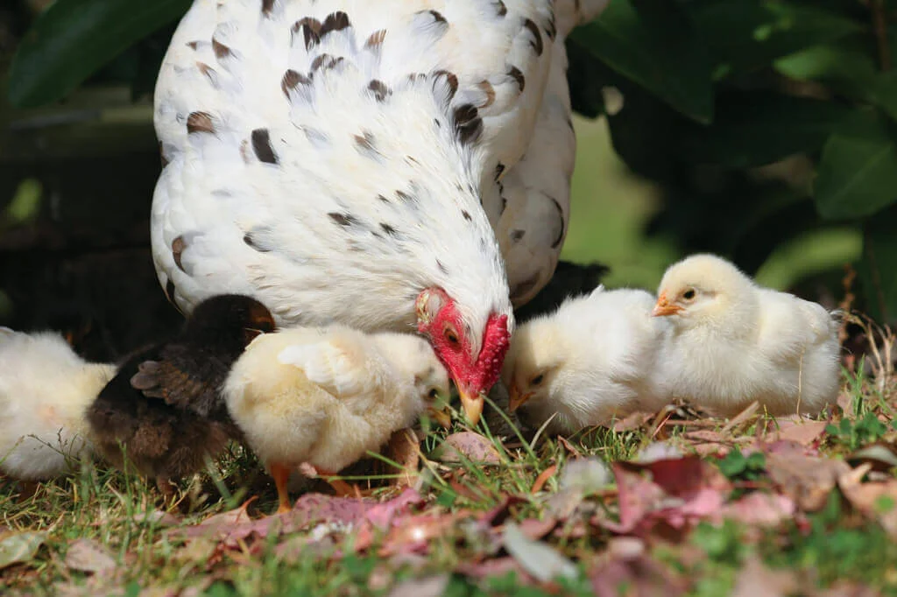
If you were a chicken ...
would you rather live crowded together in a small cage with other chickens
or
in a sanctuary with plenty of room to run around?

Slide 11
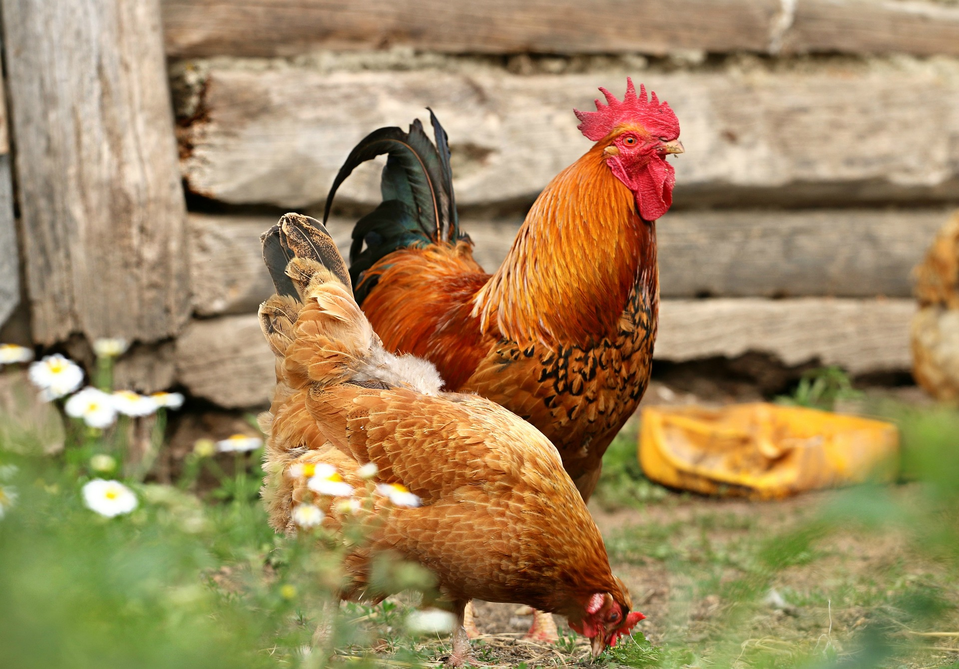
Chicken Facts
Adult female chickens are called hens.
Adult male chickens are called roosters.
Young chickens are called chicks.

Slide 12
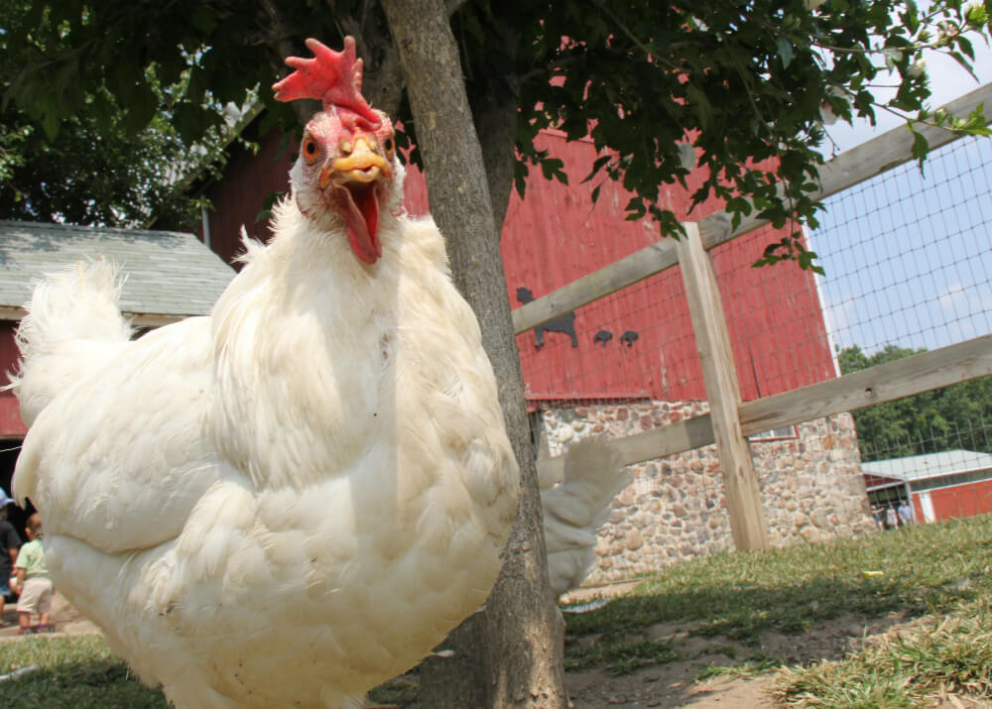
Chicken Facts
The hen sits on her eggs until they hatch. She only leaves the eggs for a short time to go eat and drink. She returns quickly to keep her eggs warm.

Slide 13
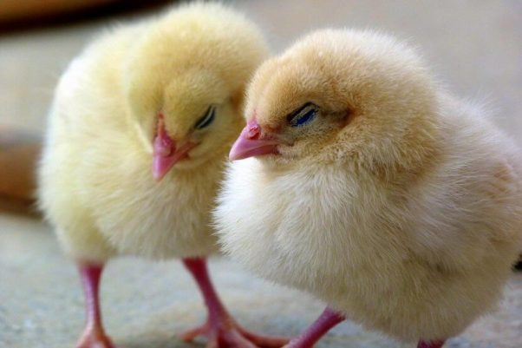
Chicken Facts
The embryo develops inside the eggshell for 21 days until, finally, the chick pecks a hole in the eggshell and hatches.

Slide 14
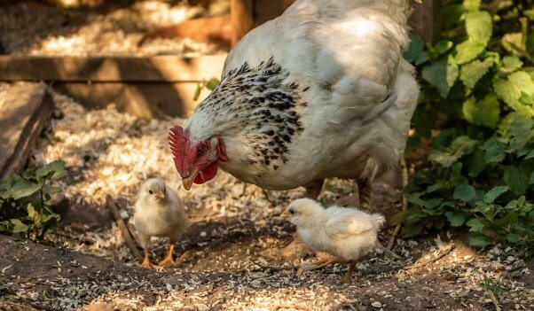
Chicken Facts
While the eggs are developing, the mother hen rotates them to keep them healthy. She also softly clucks to them.

Slide 15
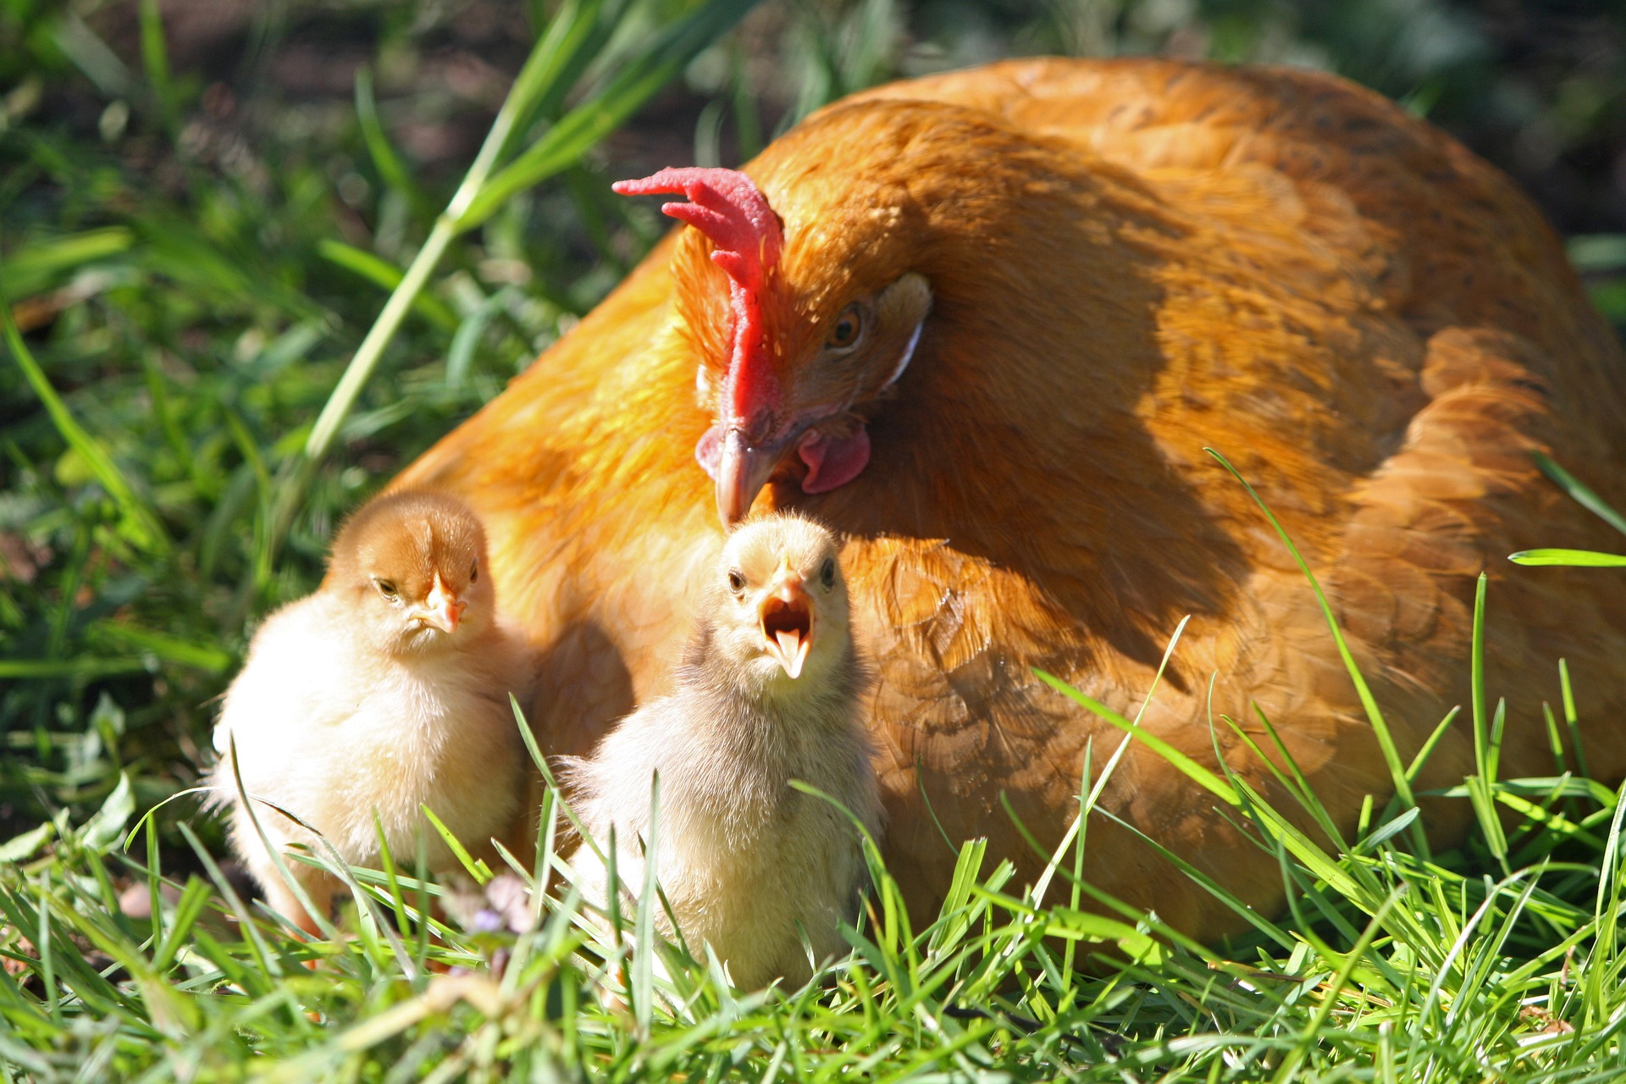
Chicken Facts
Mother hens protect their chicks and shield them from rain with their wings. Calling a frightened person a “chicken” is wrong.

Slide 16
Day 1
The brain, eyes, and nervous system begin to form.
Notes:
The nervous system is what allows the chicken to feel pain.

Slide 17
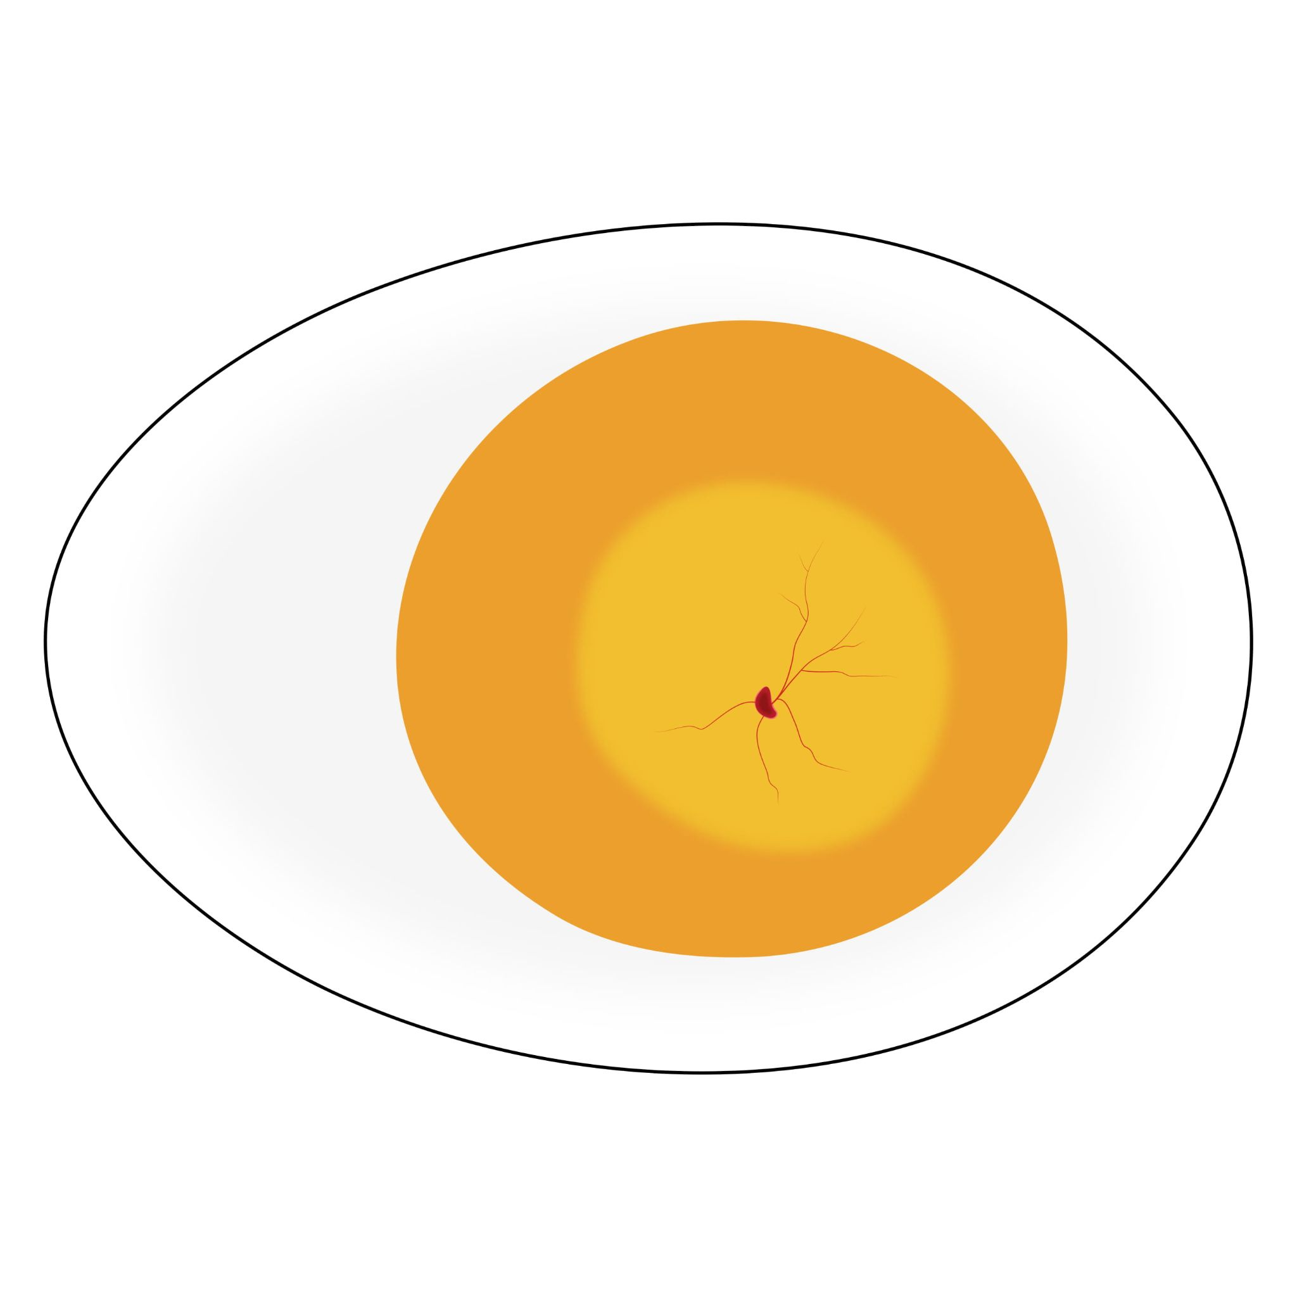
Day 2
The heart begins to form—and beat! Ears also begin to form.

Slide 18
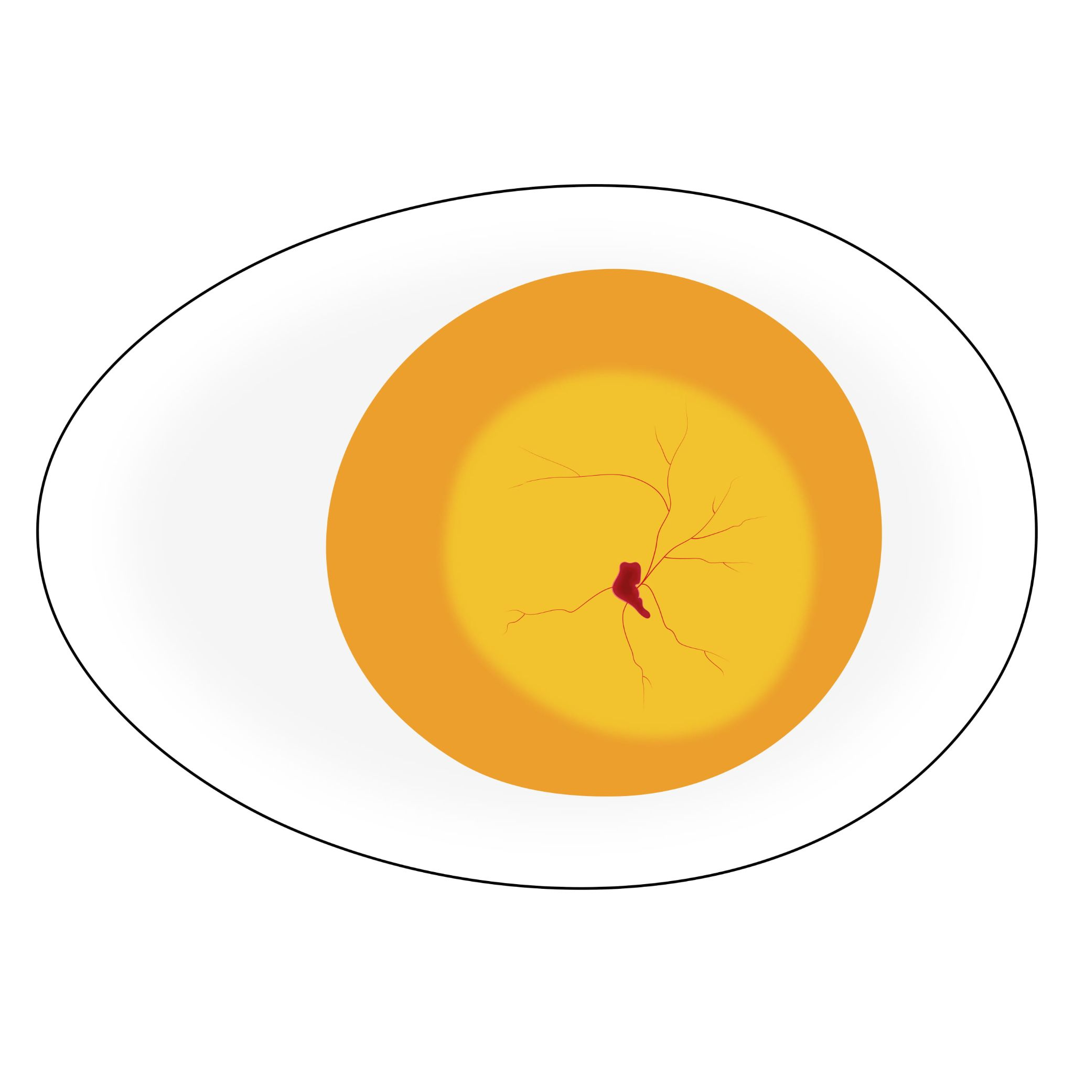
Day 3
The tongue begins to form.
The tail appears.
Wings and legs are starting to grow.
Other organs (the liver, kidneys, and lungs) start to appear.

Slide 19
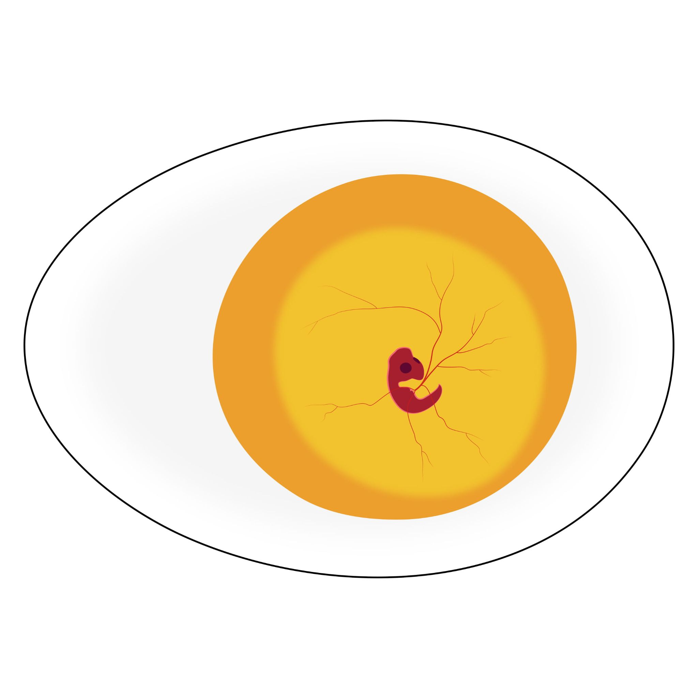
Day 4
Toes begin to form.

Slide 20
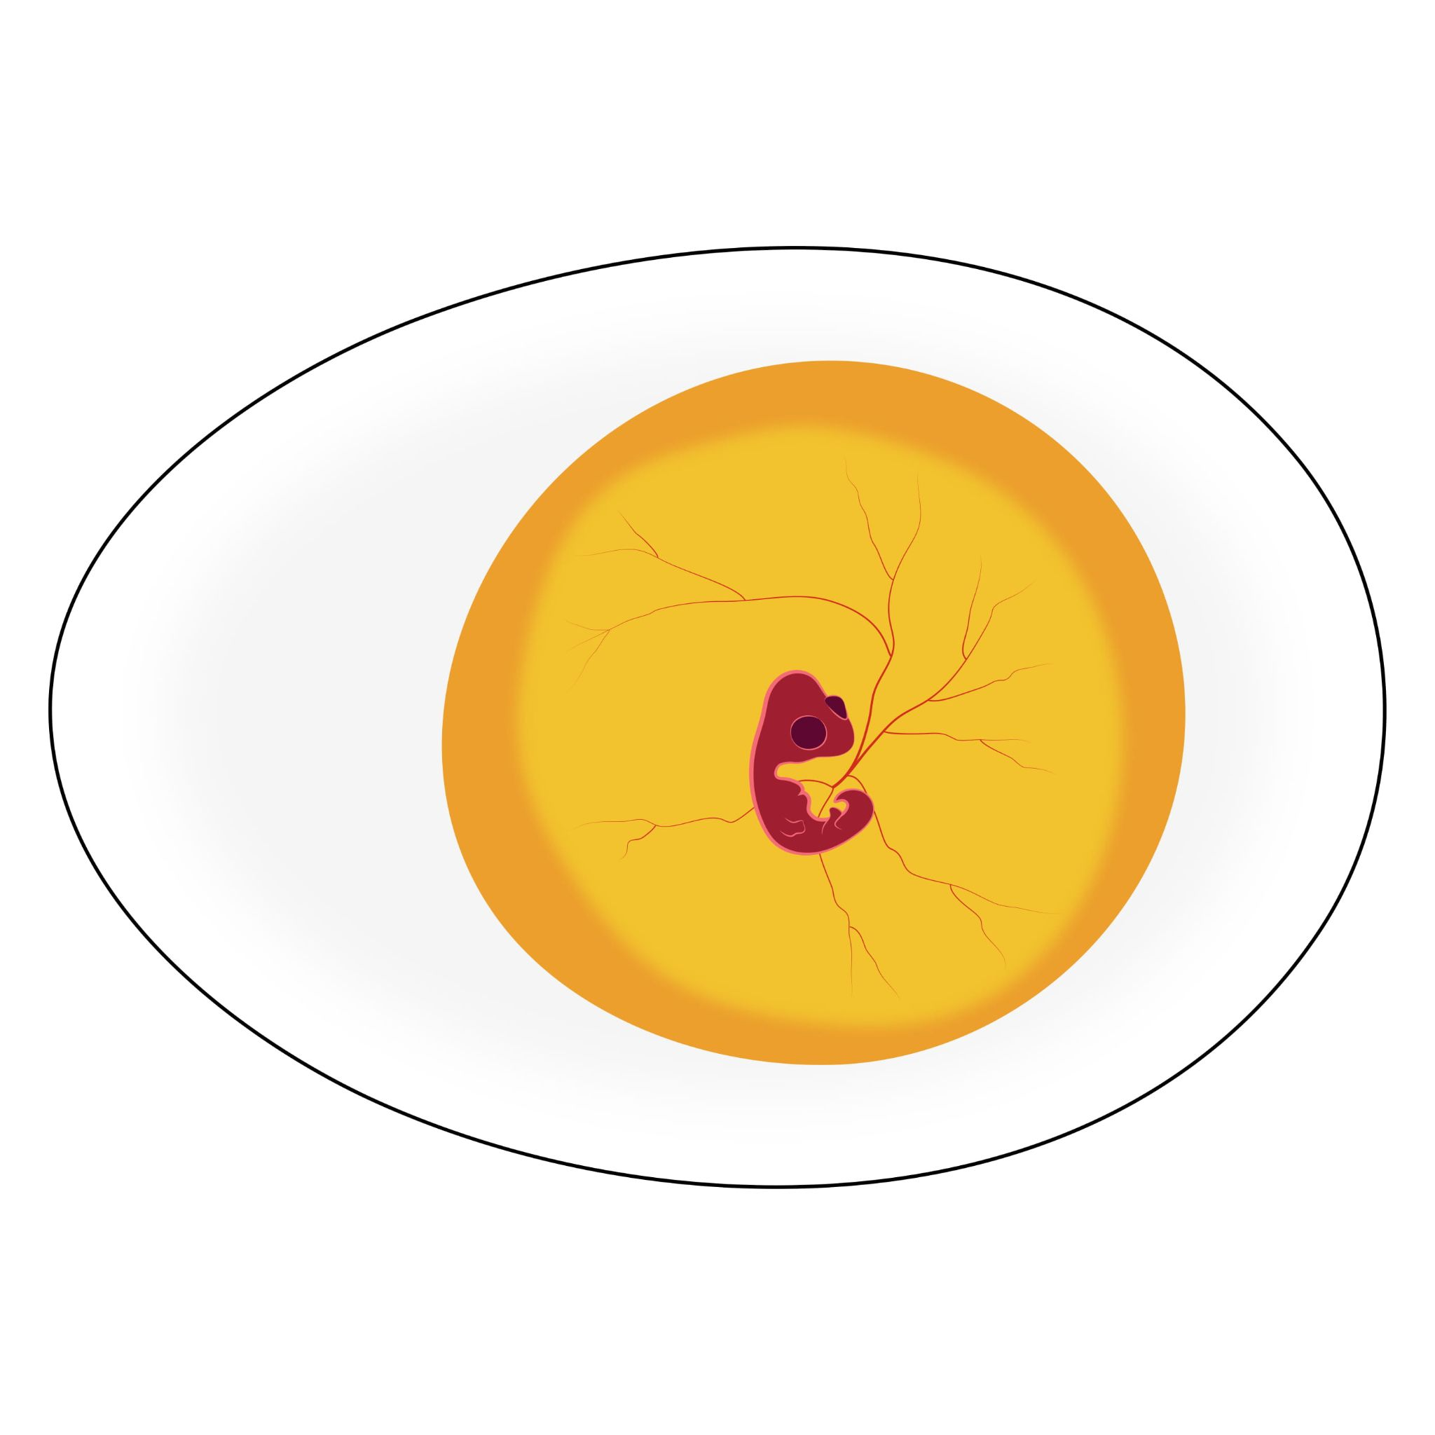
Day 5
Reproductive organs begin to form.
Leg bones begin to form.

Slide 21
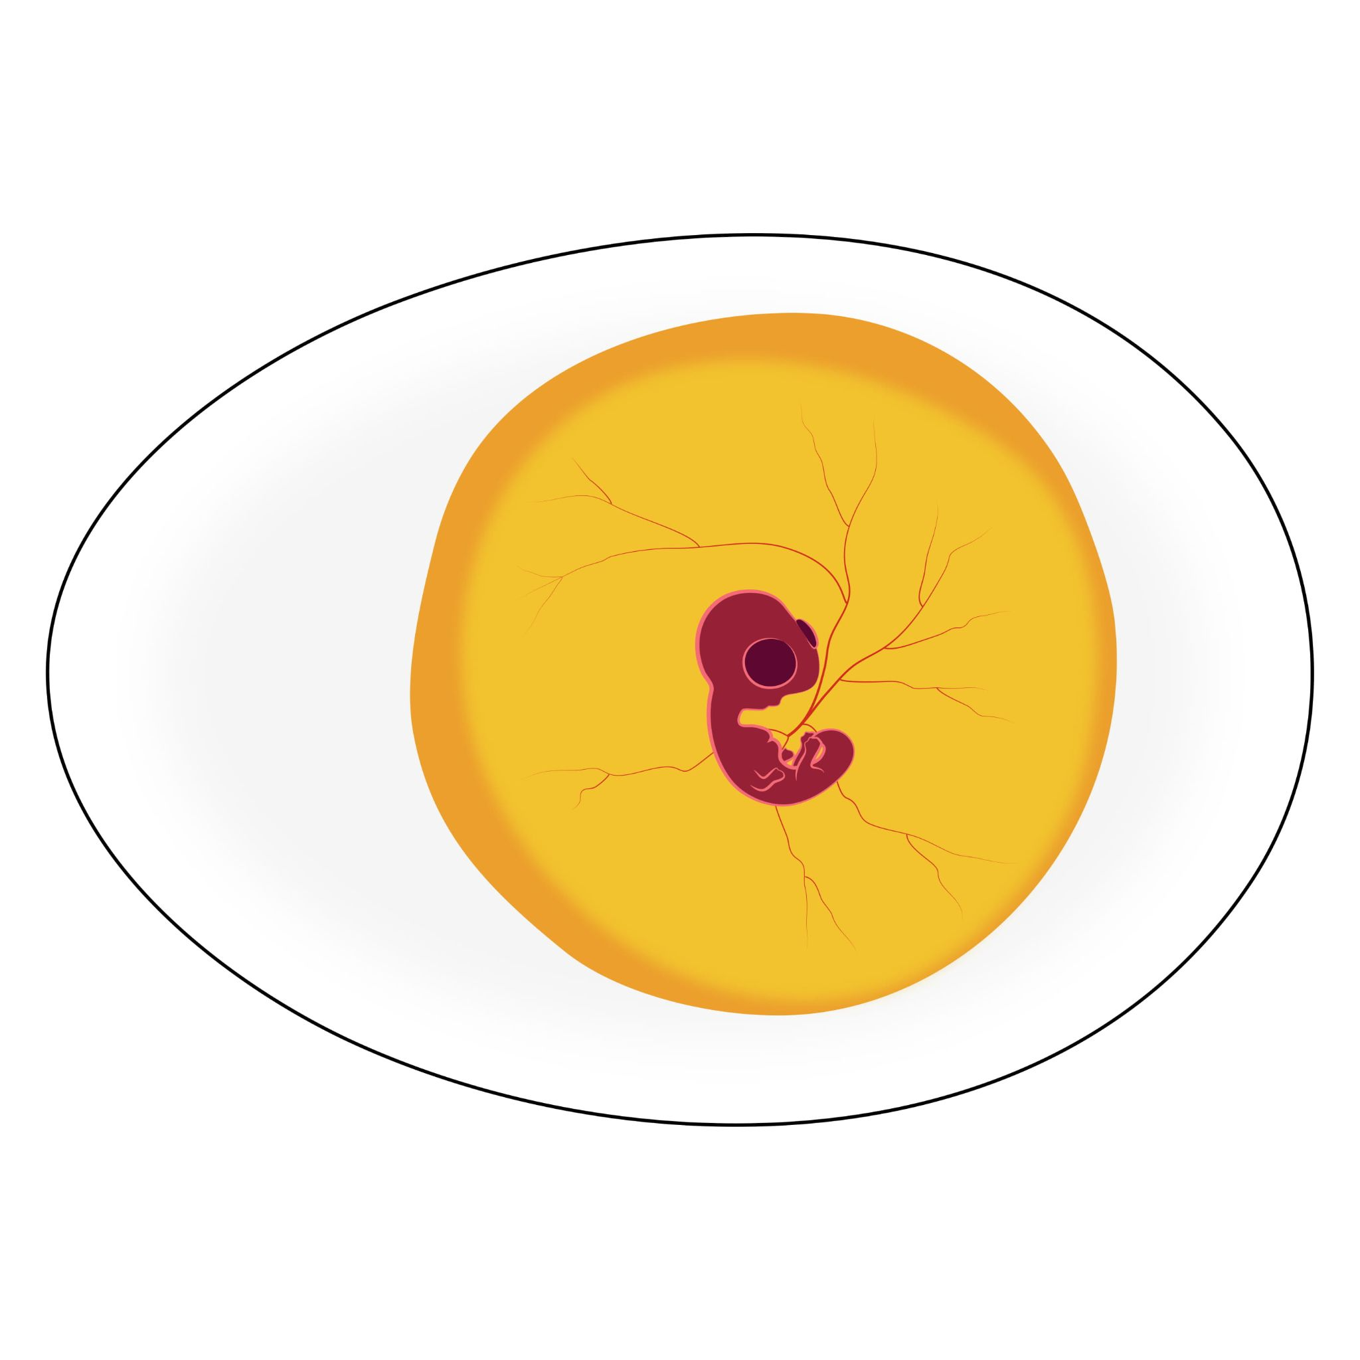
Day 6
The beak becomes visible.
The wings bend at the elbow.
Ribs begin to appear.
The “gizzard” begins to form.
The intestines begin to loop.
Notes:
The gizzard is part of the chicken’s stomach that helps break food down.

Slide 22
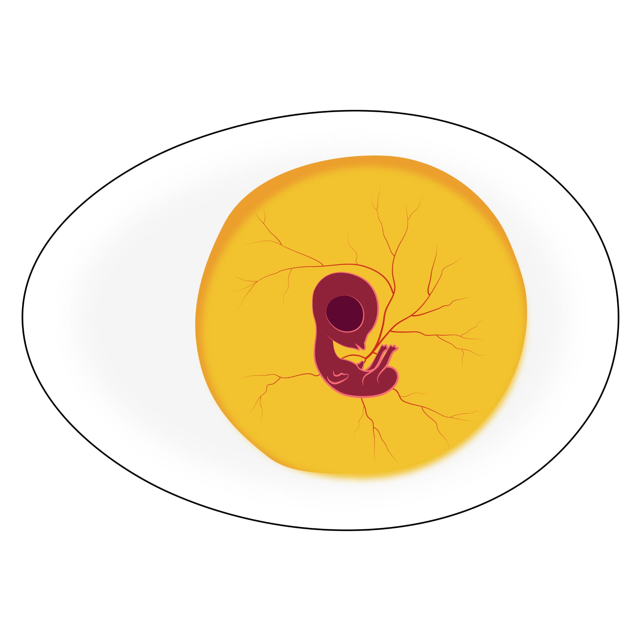
Day 7
Feathers begin to form.
The legs bend at the knee.

Slide 23
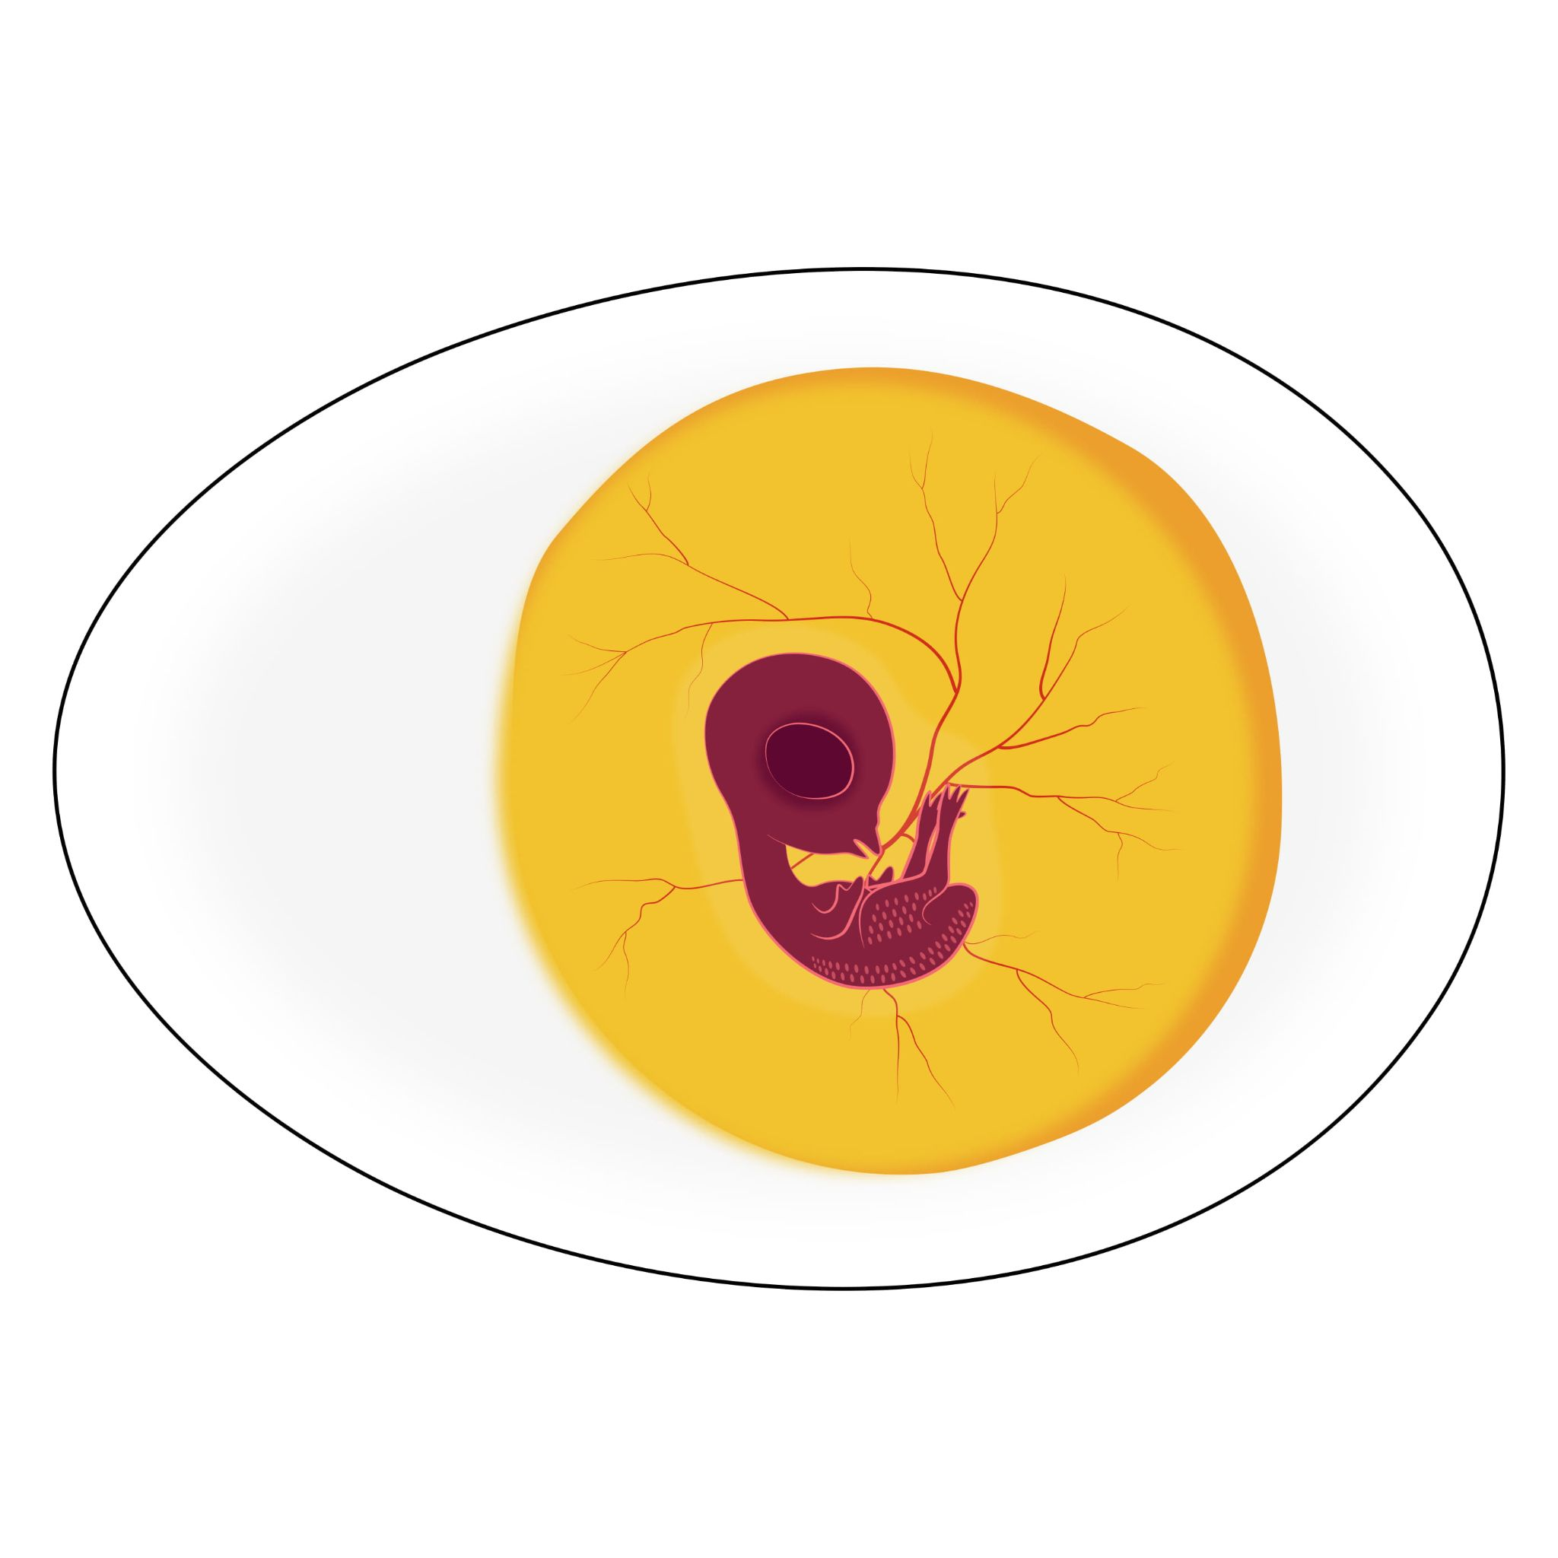
Day 8
Feathers continue to form.
The “egg tooth” begins to form.
Inner eyelids begin to form.
Notes:
The egg tooth is a hard part of the beak that will help the chicks break out of their shells. Chickens have several eyelids that give them extra protection against dust and dirt.

Slide 24
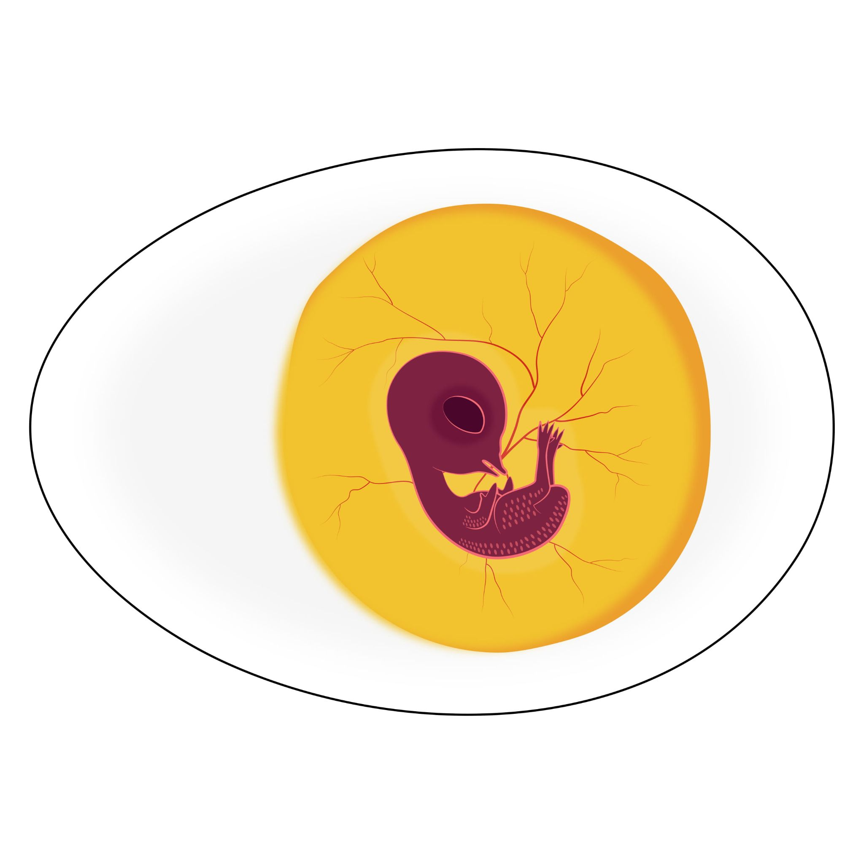
Day 9
Upper eyelids begin to cover the eyes.
Kneecaps begin to form.

Slide 25
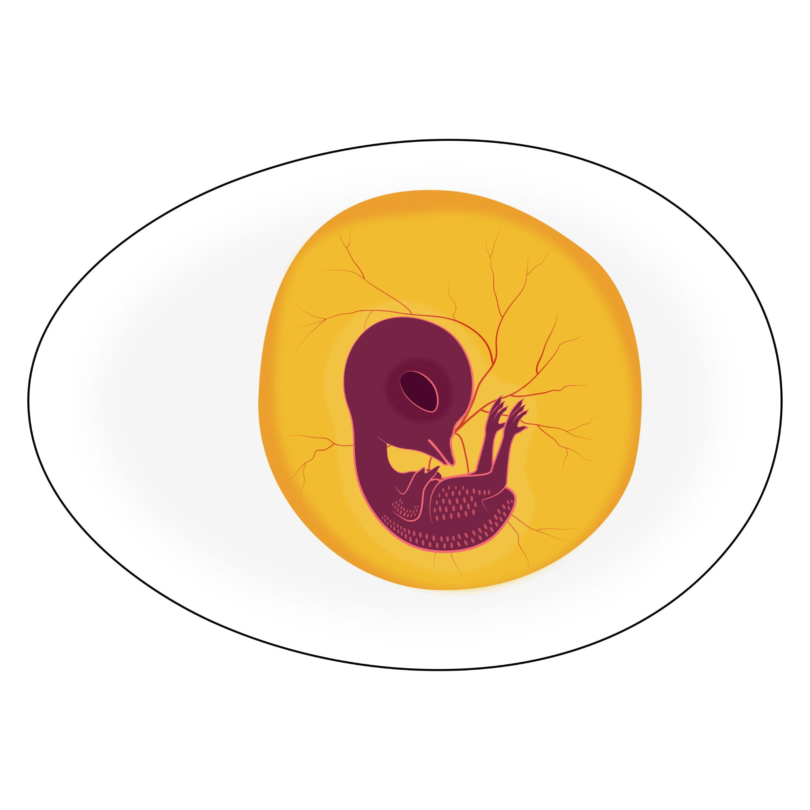
Day 10
Claws begin to form.
The “comb” is visible.
Flight feathers appear.
Lower eyelids develop.
Notes:
The comb is what sits on top of a chicken’s head. It’s often red and plump.

Slide 26
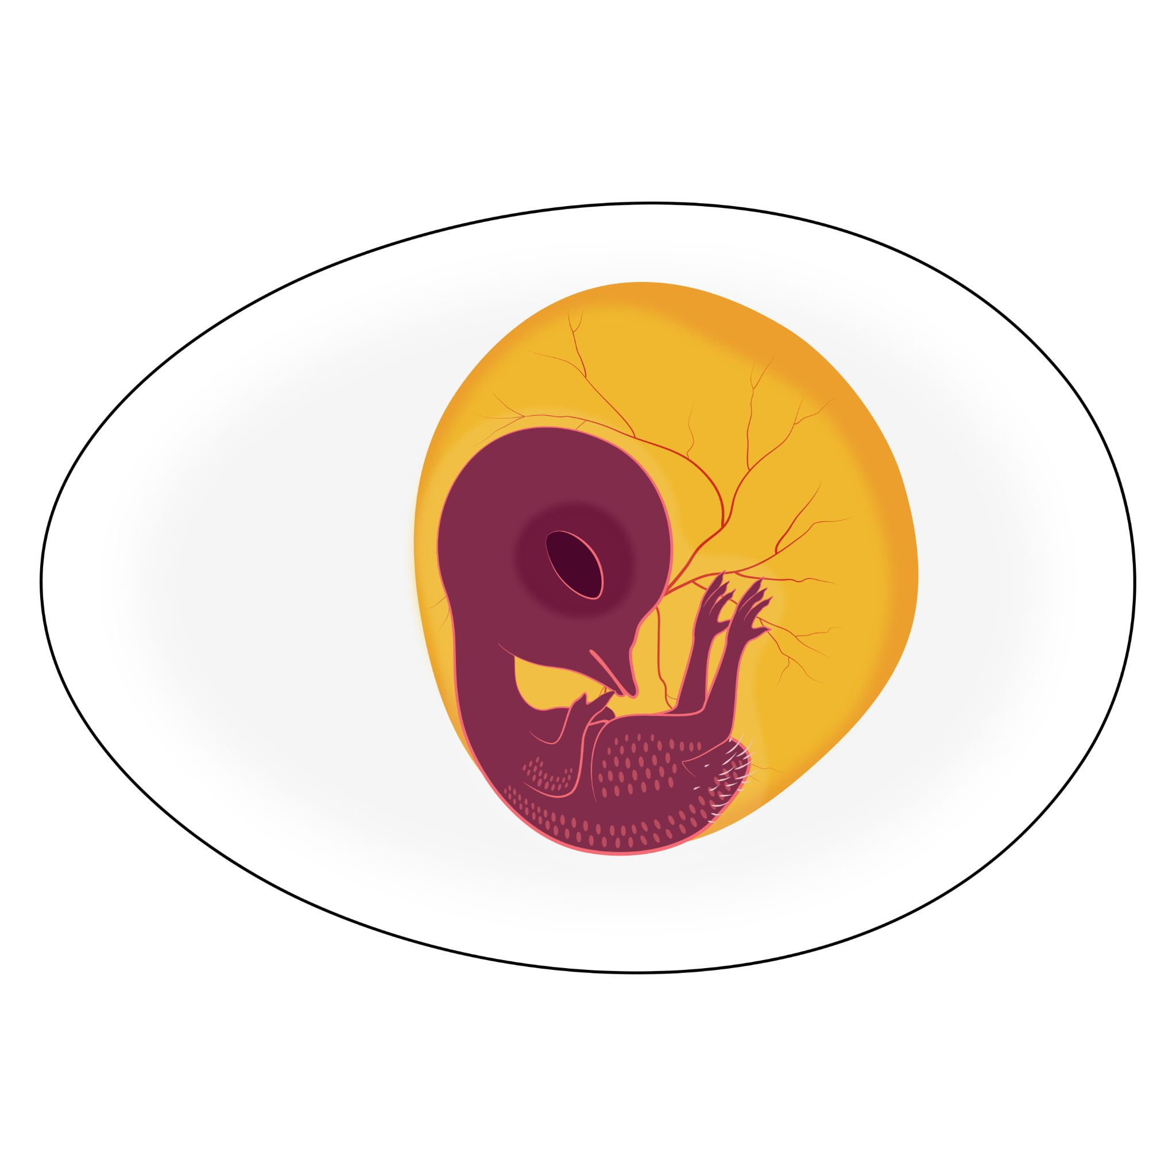
Day 11
The claws begin to curve downward.
The bottoms of the feet become padded.
The beak begins to harden.

Slide 27
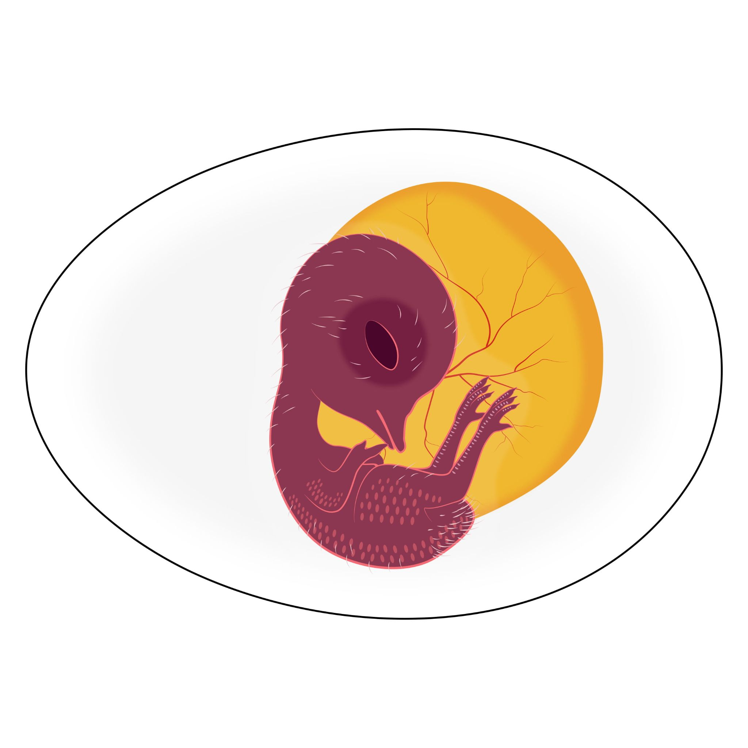
Day 12
Scales appear on the lower legs.
The ribs begin to harden.

Slide 28
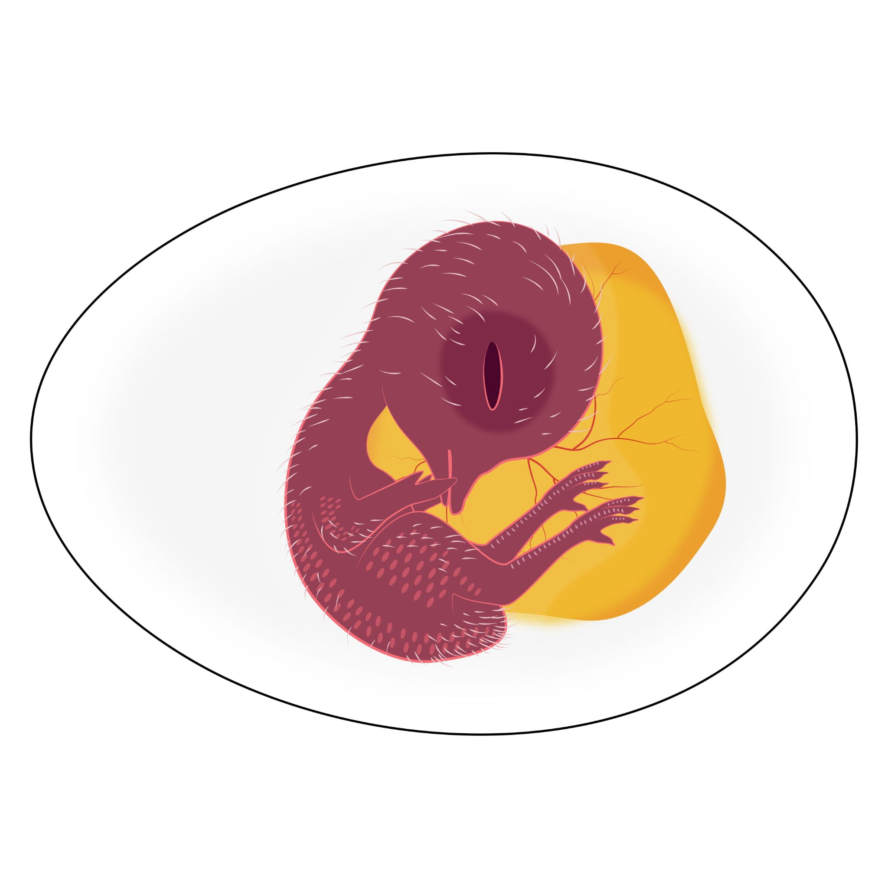
Day 13
The “fingers” of the wings continue to develop.
The left and right collarbones fuse.

Slide 29
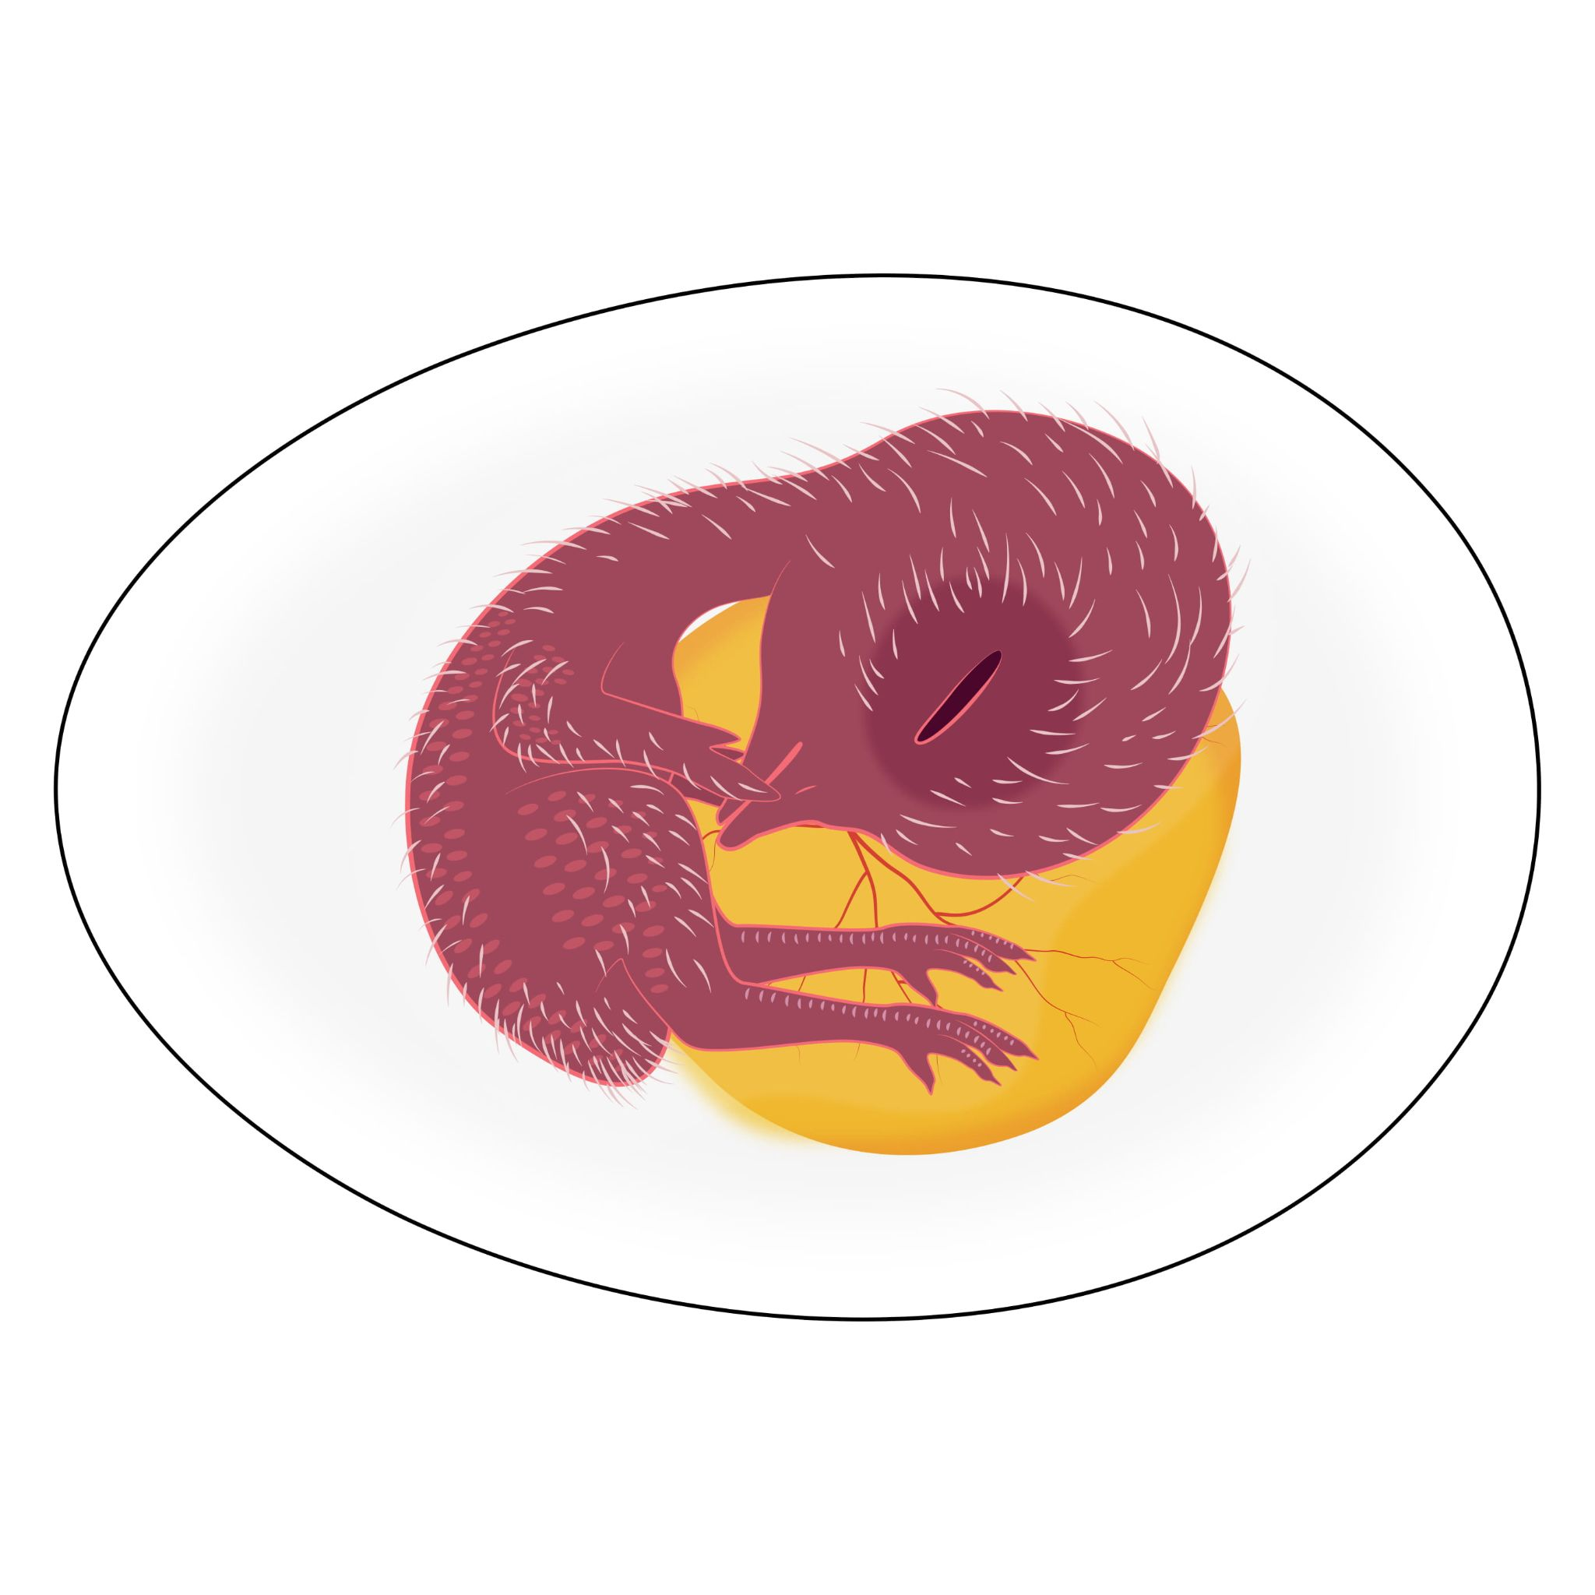
Day 14
The skull begins to harden.

Slide 30
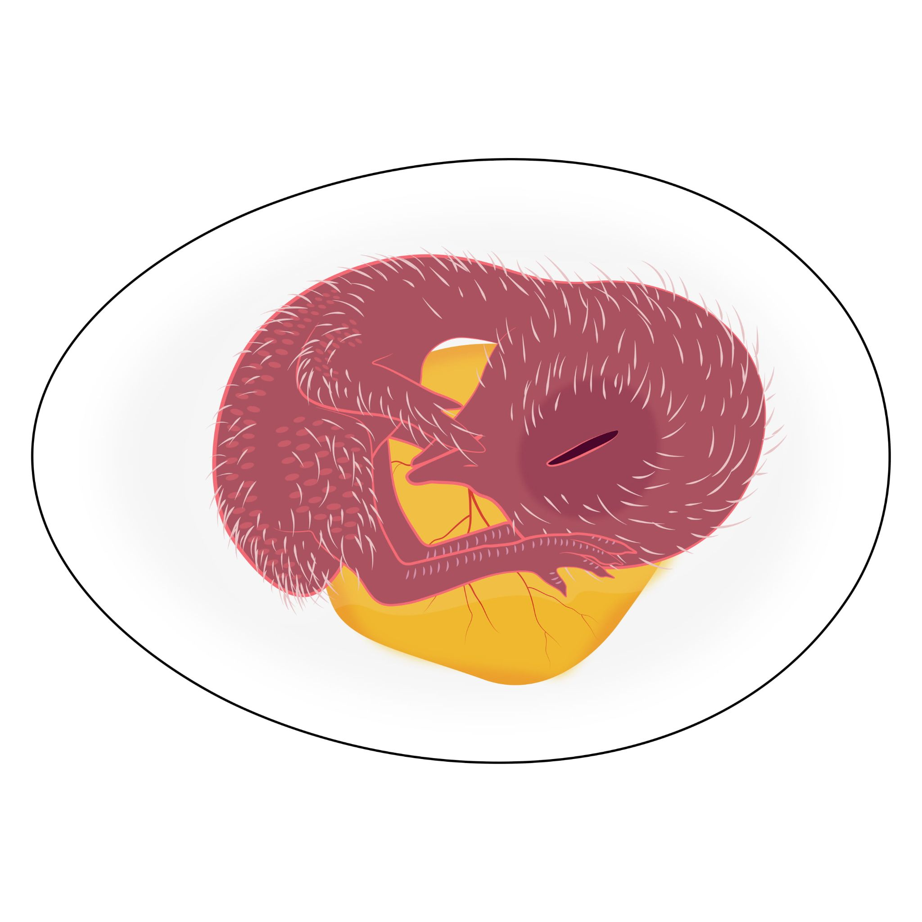
Day 15
The scales, claws, and beak are becoming firm.

Slide 31
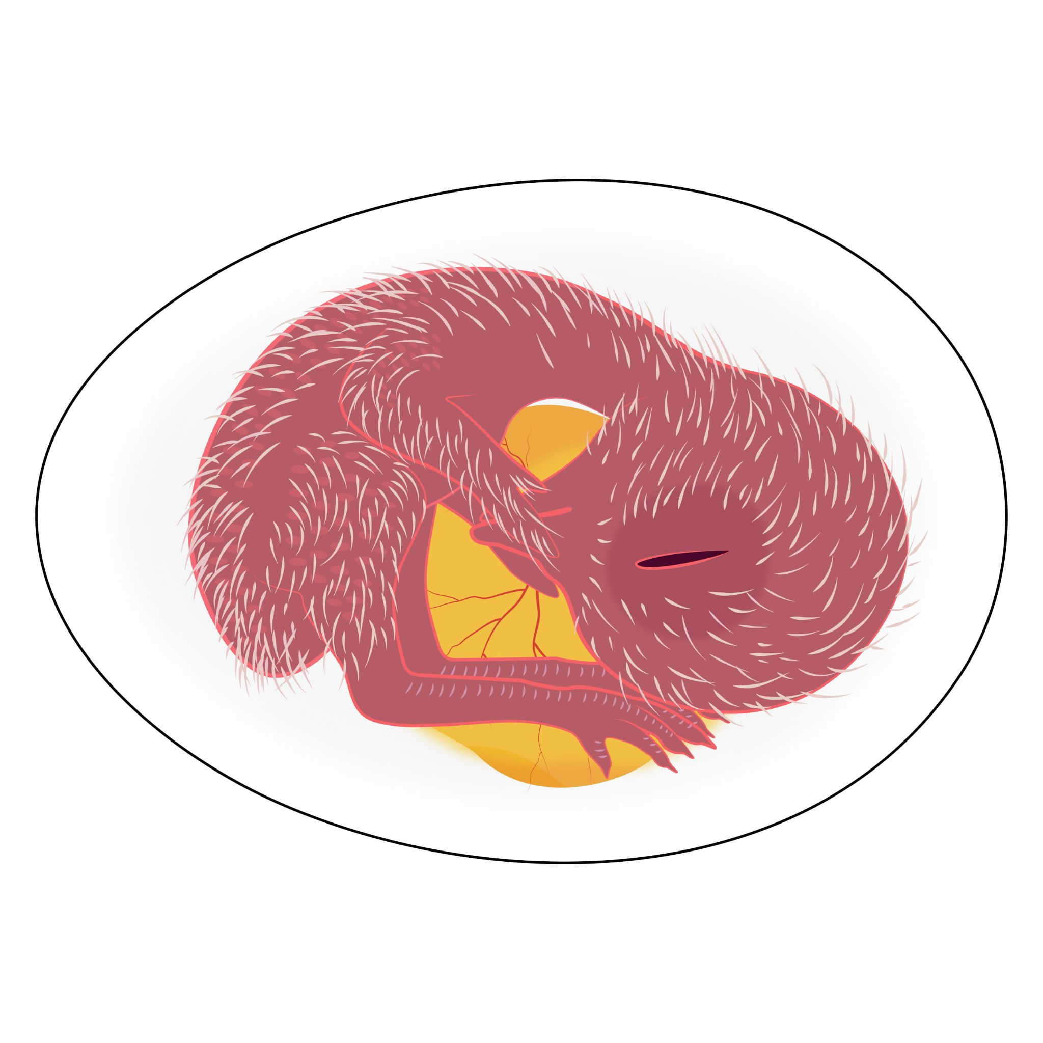
Day 16
The beak turns toward the “air cell.”
There is a lot of movement.
Notes:
The air cell is an empty space located on the long ends of the egg.

Slide 32
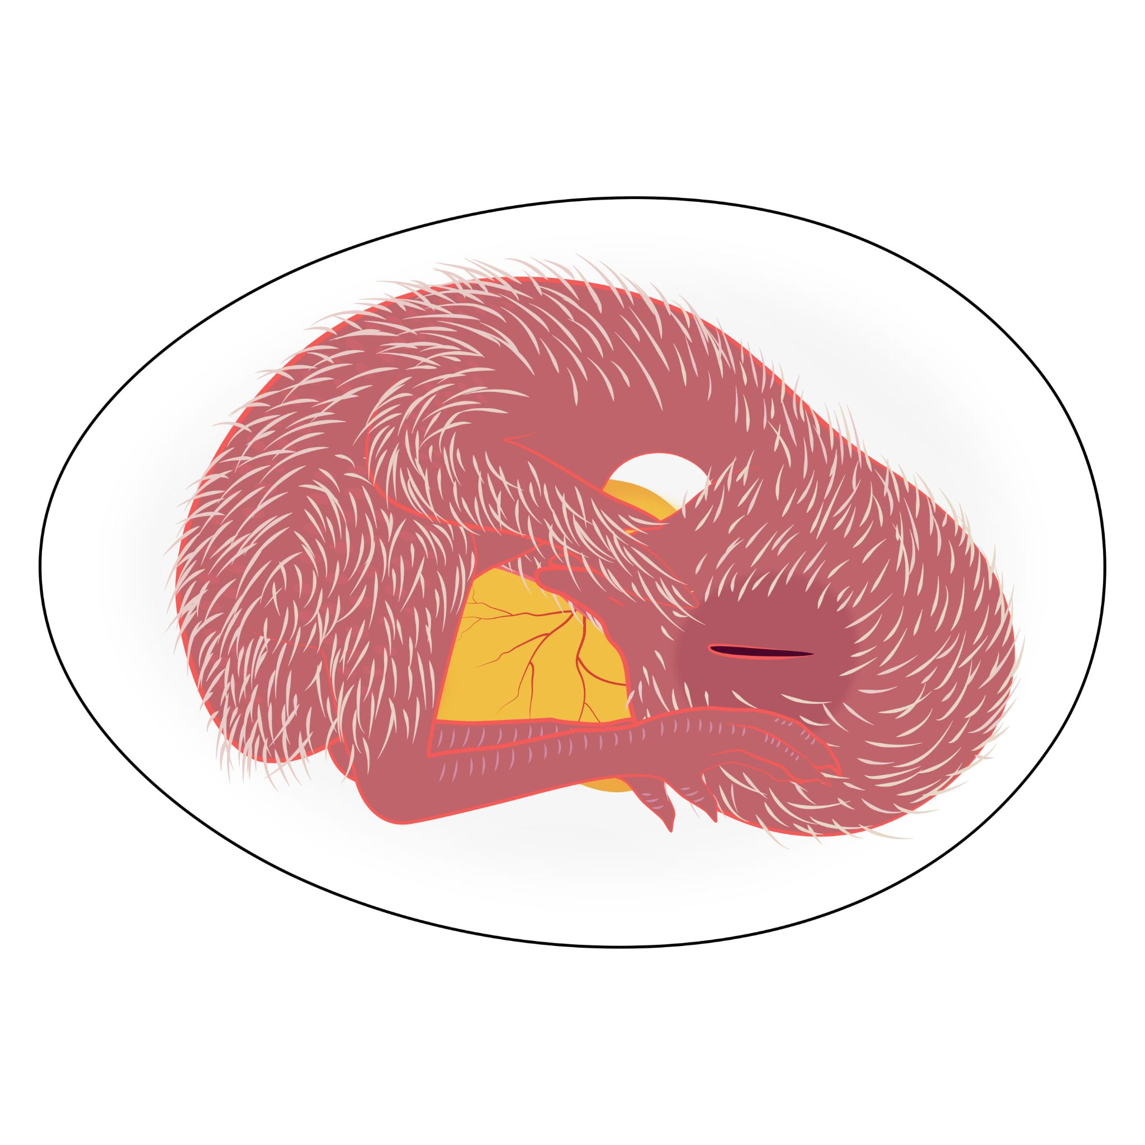
Day 17
The beak keeps turning toward the air cell.

Slide 33
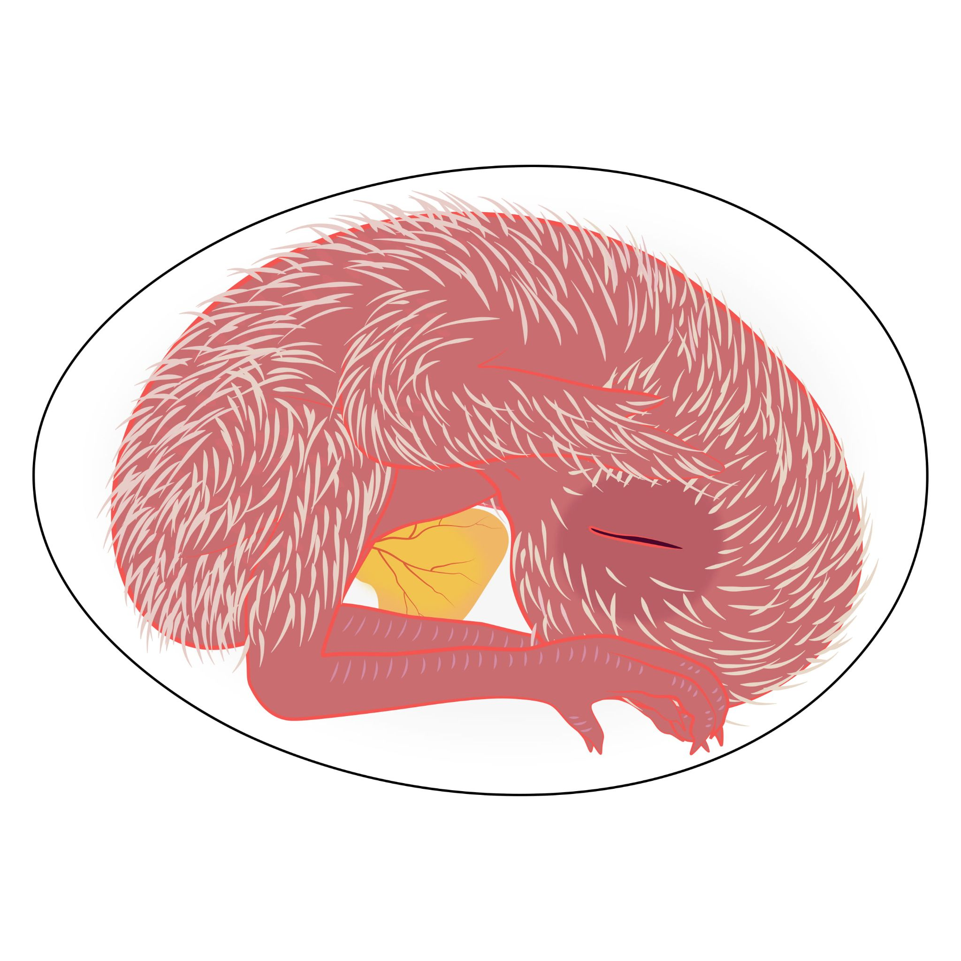
Day 18
The beak breaks through the inner shell membrane. The embryo is preparing to hatch!

Slide 34
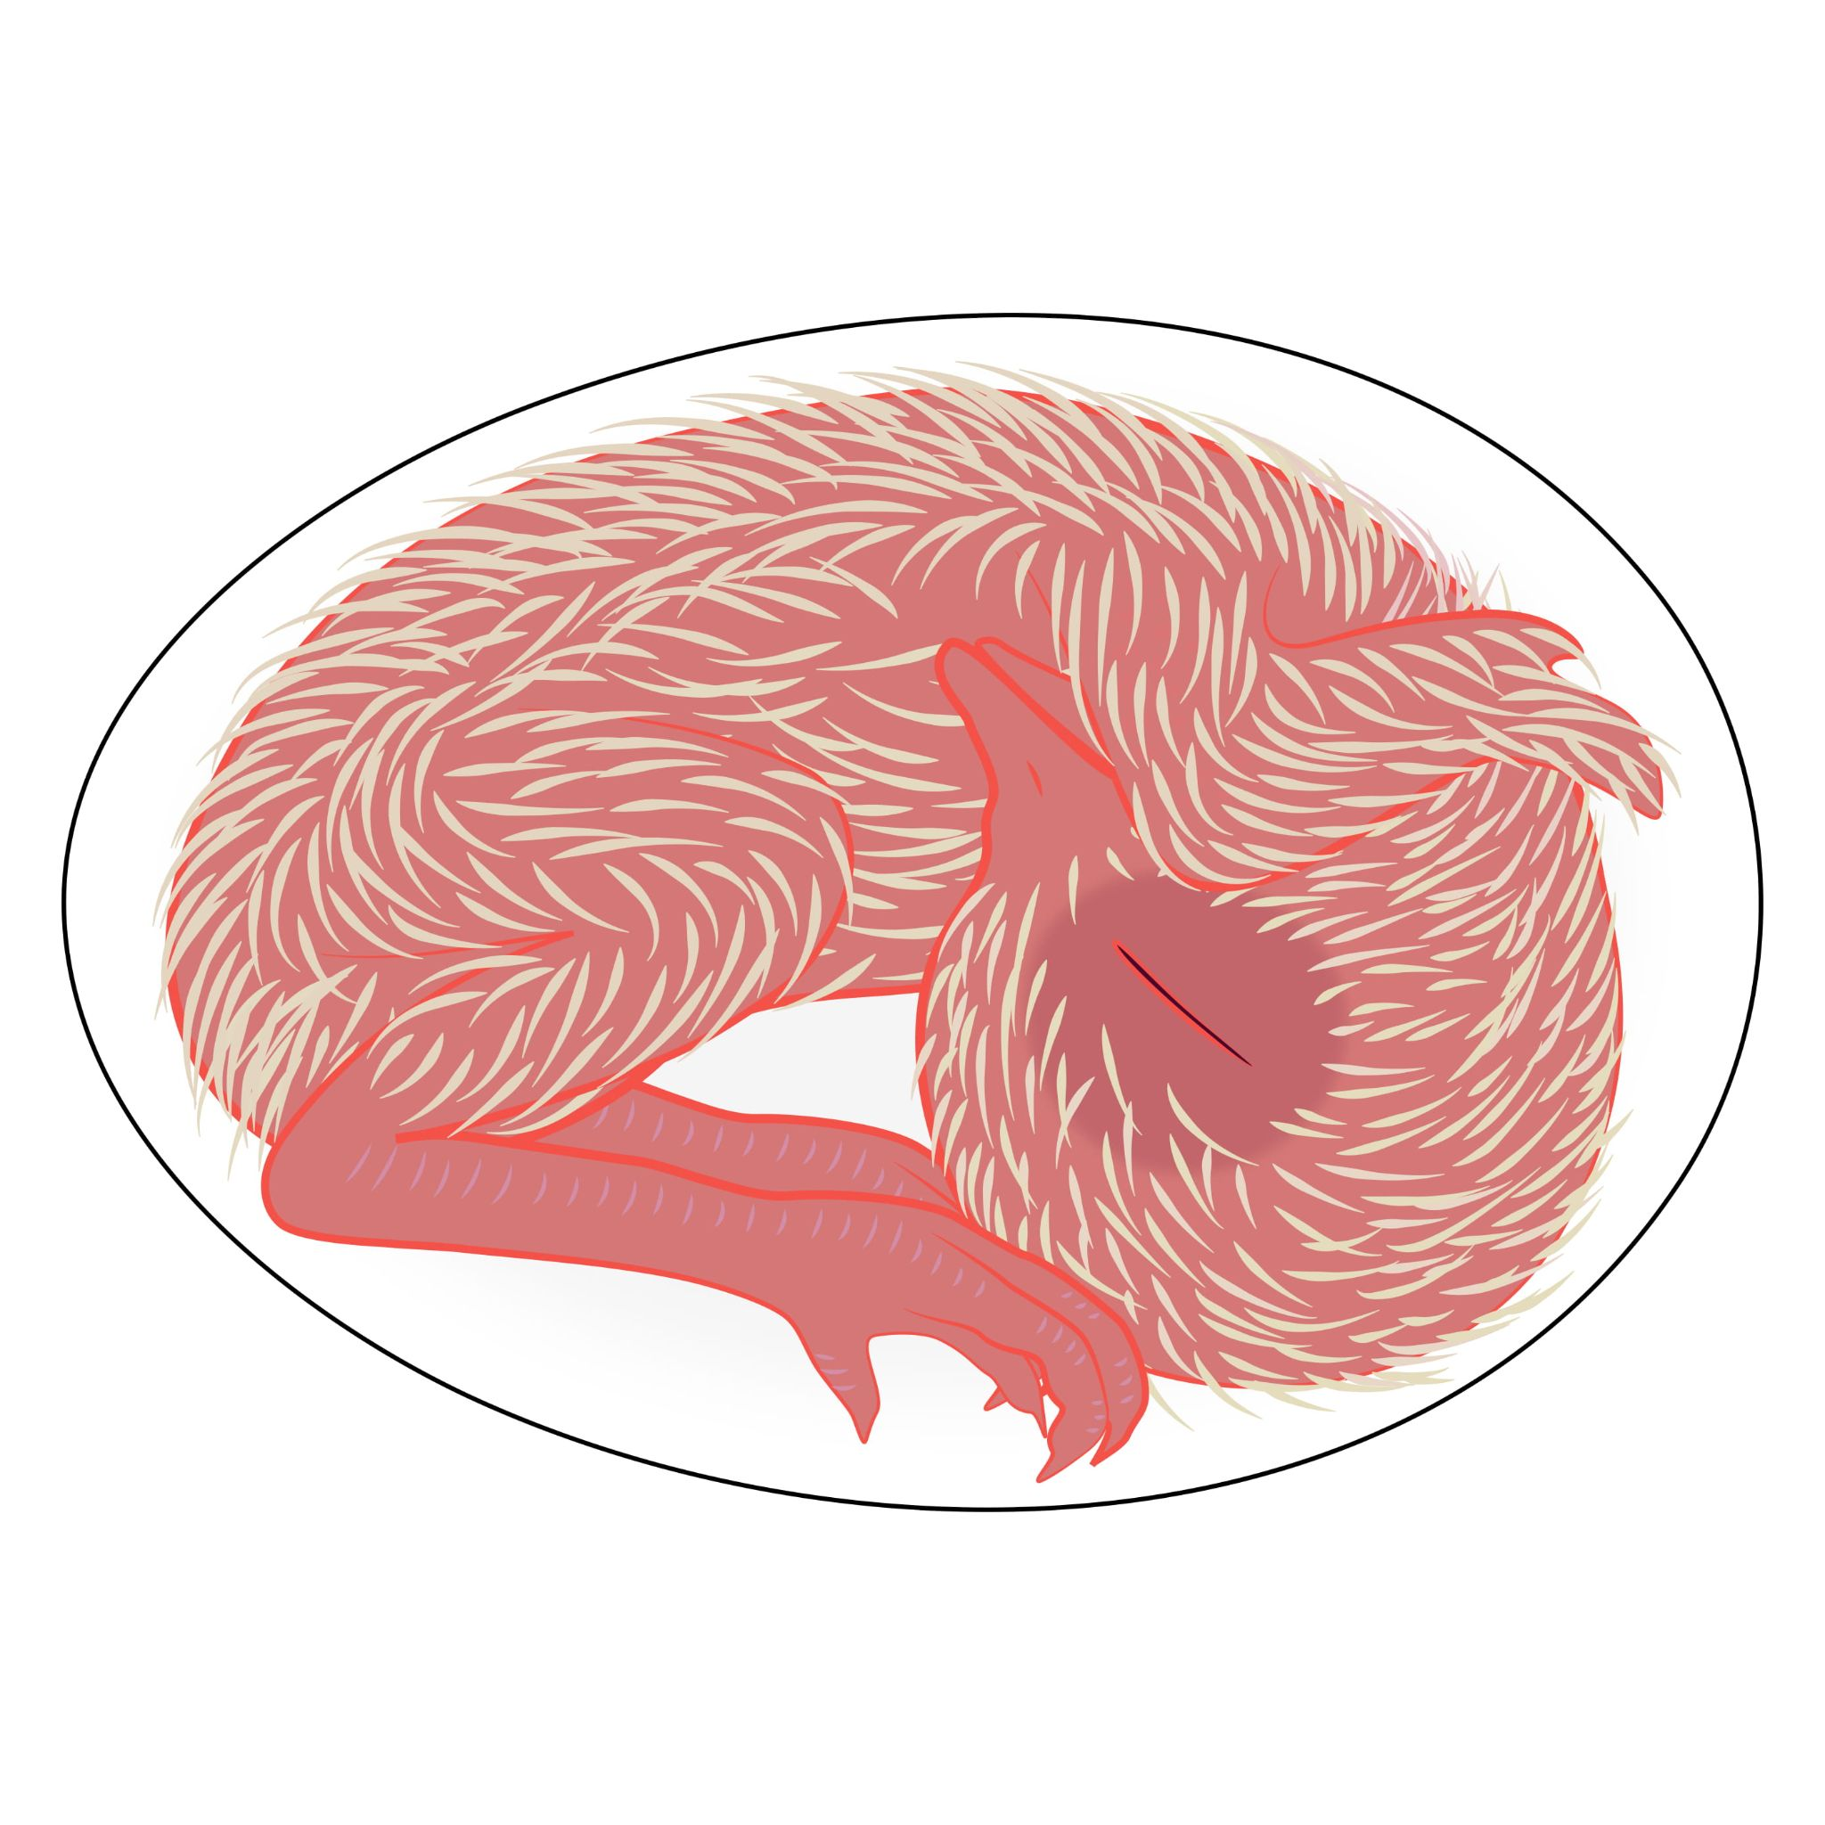
Day 19
The lungs begin to function.

Slide 35
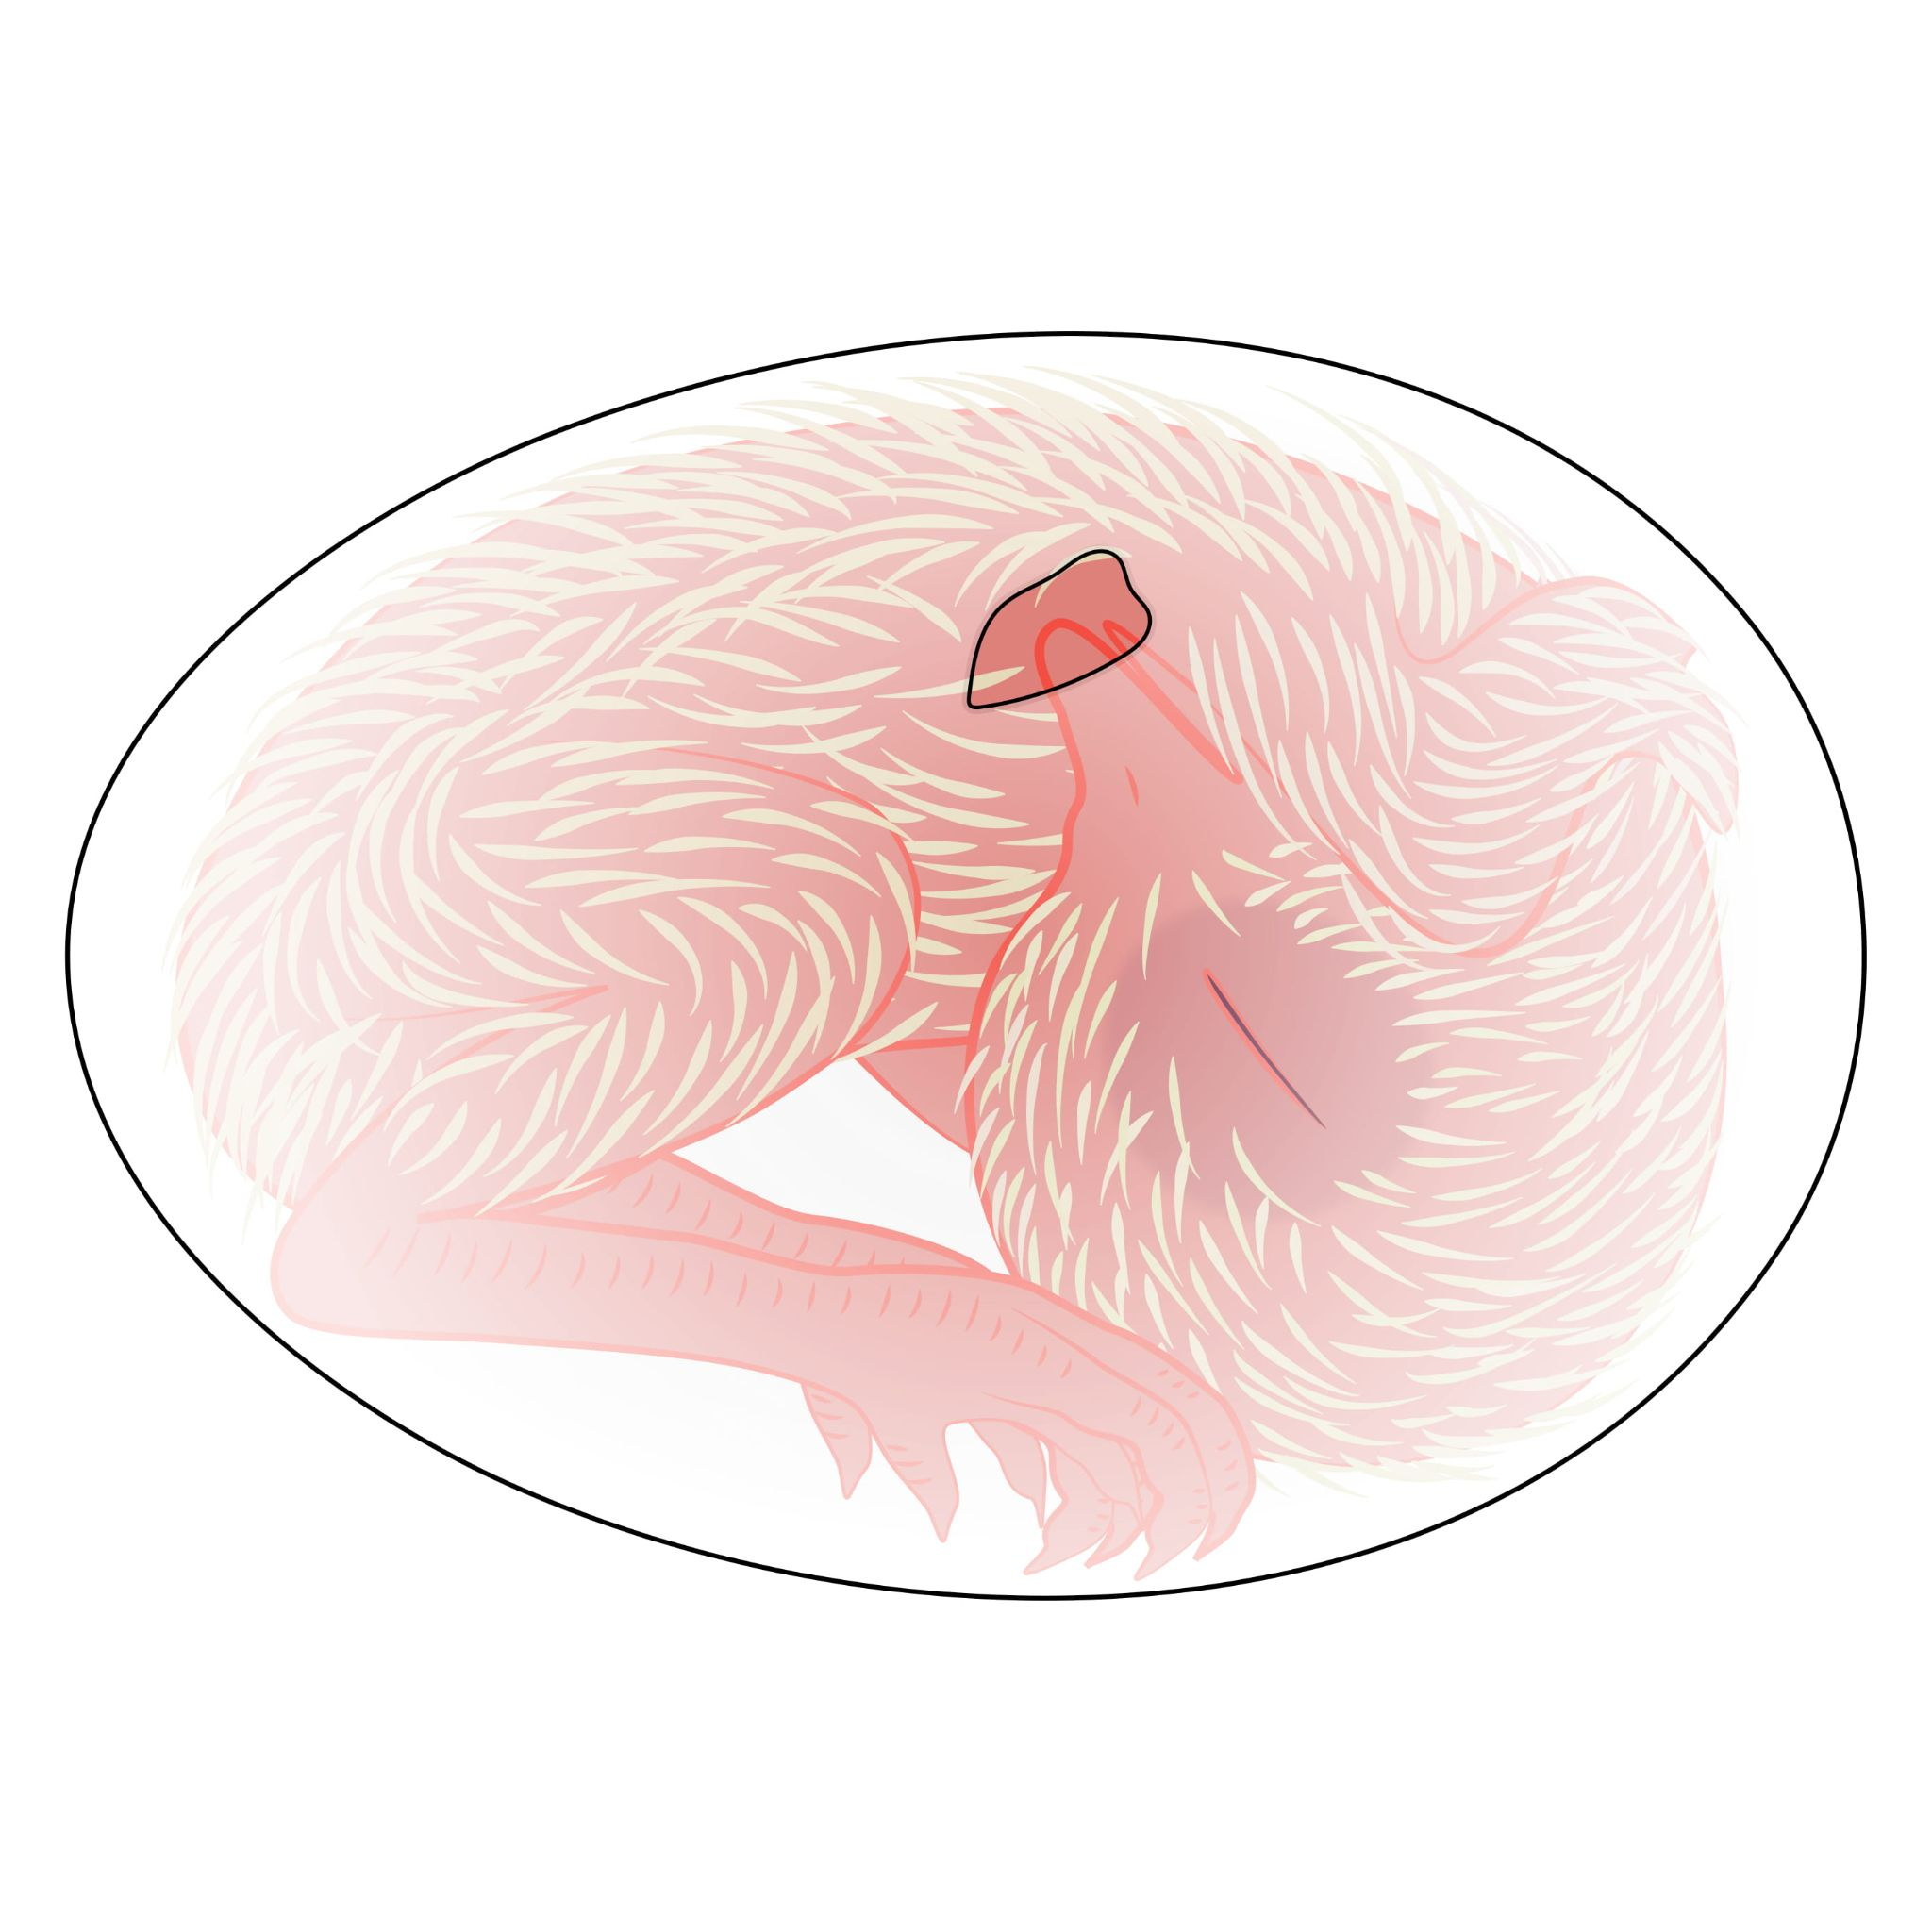
Day 20
The lungs use the air cell to breathe.

Slide 36
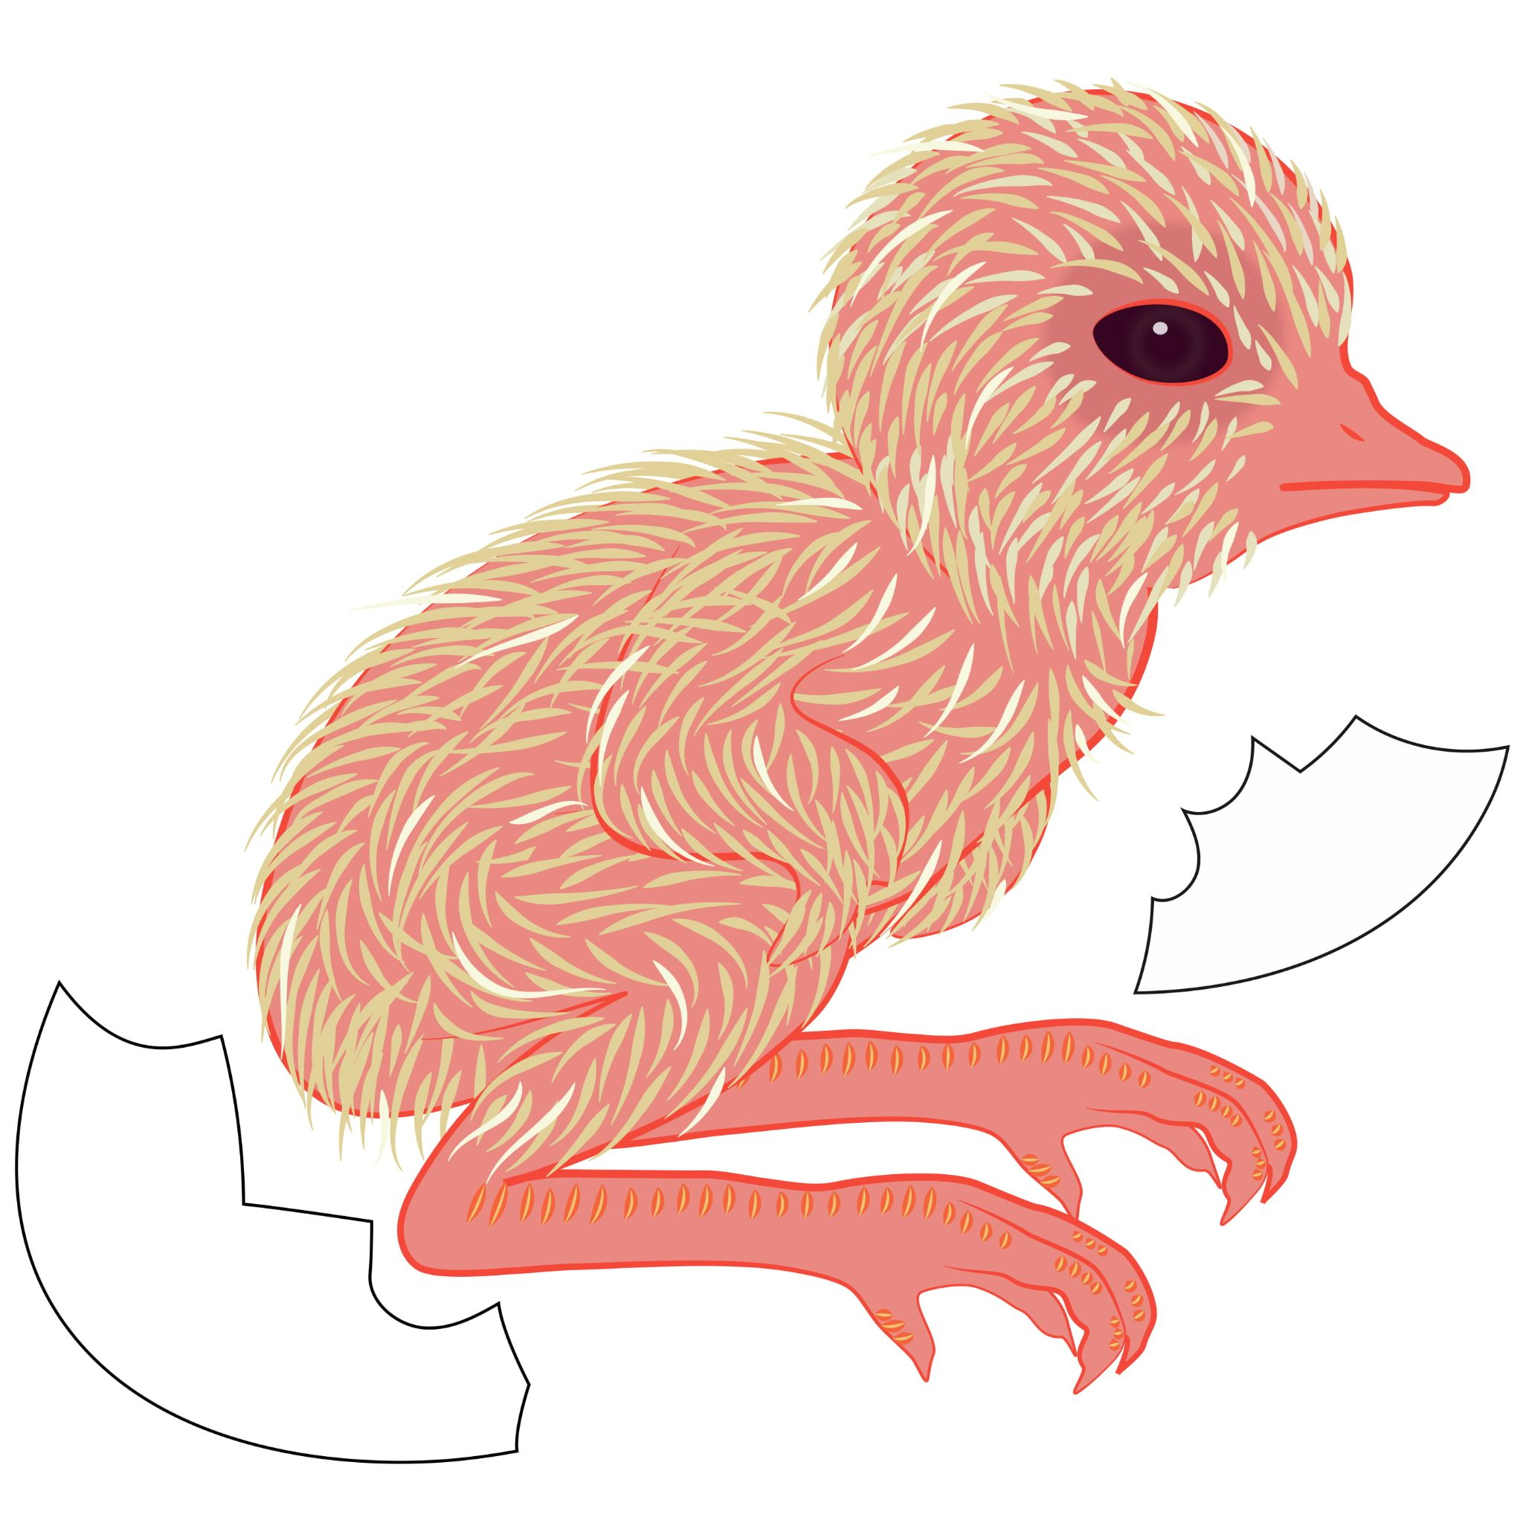
Day 21
The neck begins to wiggle.
The egg tooth breaks through the shell.
The chick has hatched!

